Slide 1
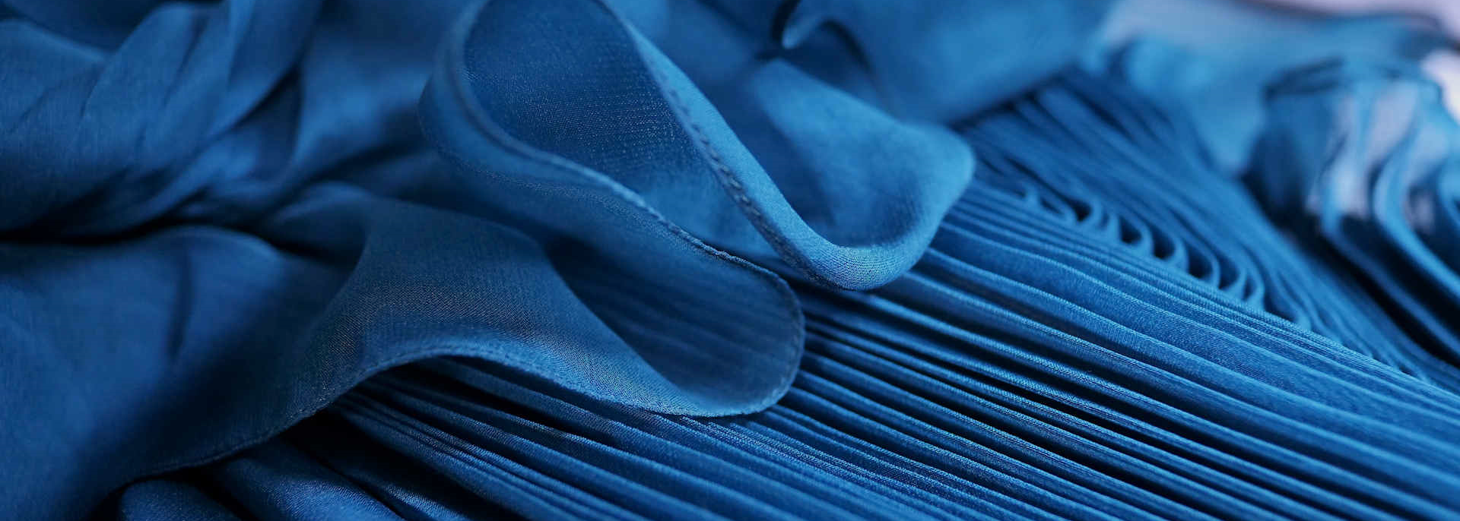



Sustainability in Textiles : Expectations & Trends
Promotion of Sustainability in the Textile and Garment Industry in Asia -FABRIC

Slide 2

Agenda
Chapter
Subject
Page
1
THE Impact
2
Stakeholder Response
3
Managing Emissions
4
Microplastics : Developments & Expectations
5
Valuing Water
6
Putting Textile Waste to Work
7
Chemicals Management : Developments & Expectations
8
PFAS : Need for Chemicals Elimination & substitution
9
Social/Labor Welfare : Developments & Expectations
10
Identifying and managing synergies, dependencies, and trade-offs

Slide 3
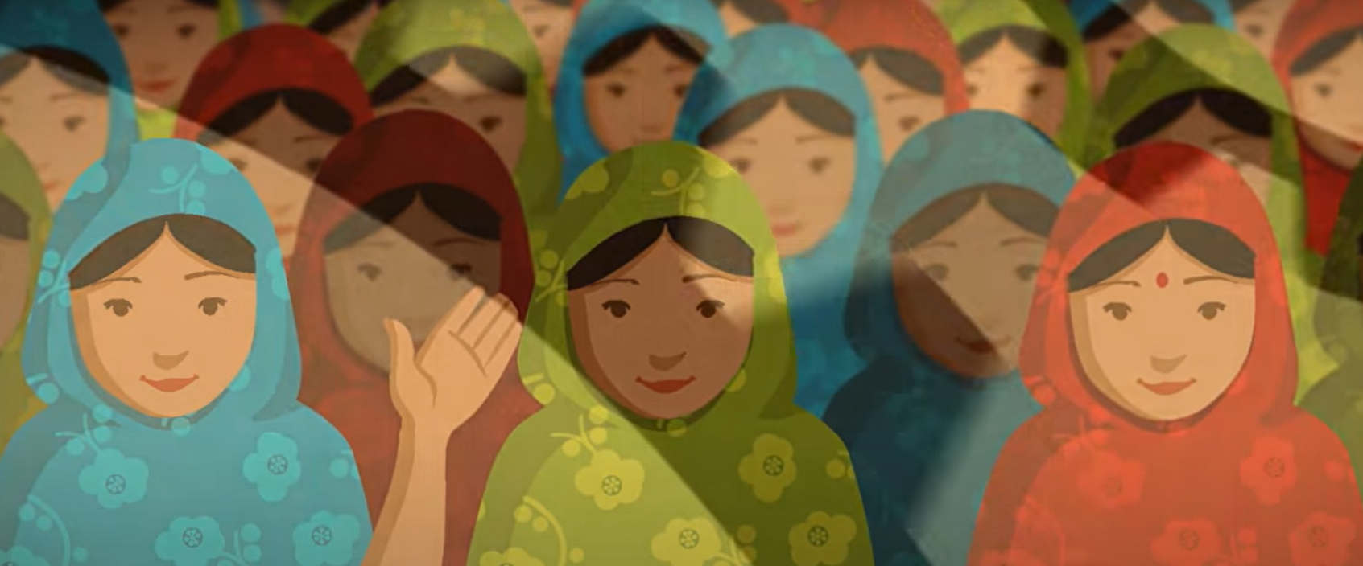

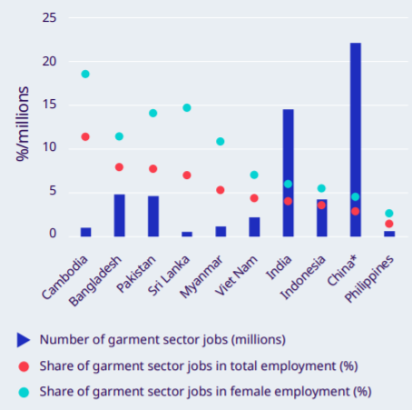
Social Impact
Image Source : ILO, 2019
Image Source : Danish Fashion Institute
Notes:
Its essential to start looking at the purpose of our industry and its impact.
This is what it does
It produces the wonderful products that allow people, allows all of us to express ourselves, our feelings, and is one of the factors that makes us feel good

Slide 4
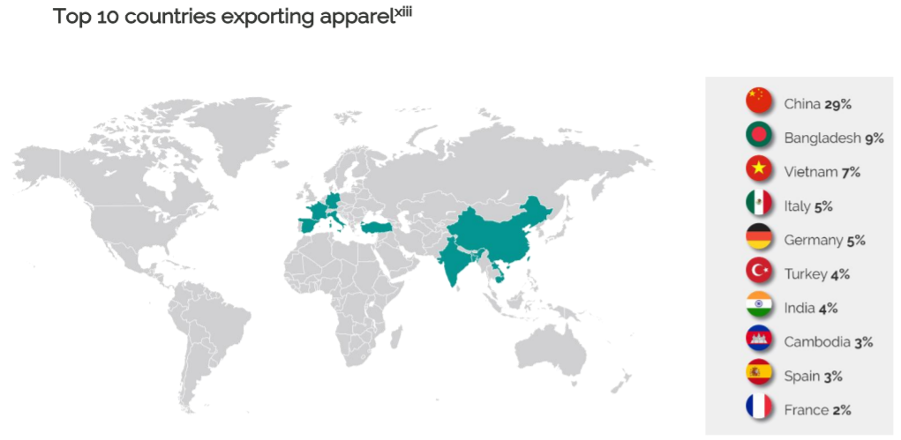
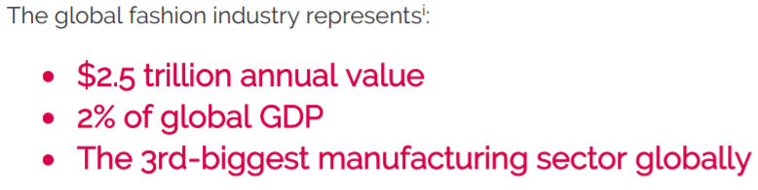
Economic Impact
https://www.sedex.com/wp-content/uploads/2021/06/Sedex-Insights-Apparel-Manufacturing-June-2021-1.pdf

Slide 5
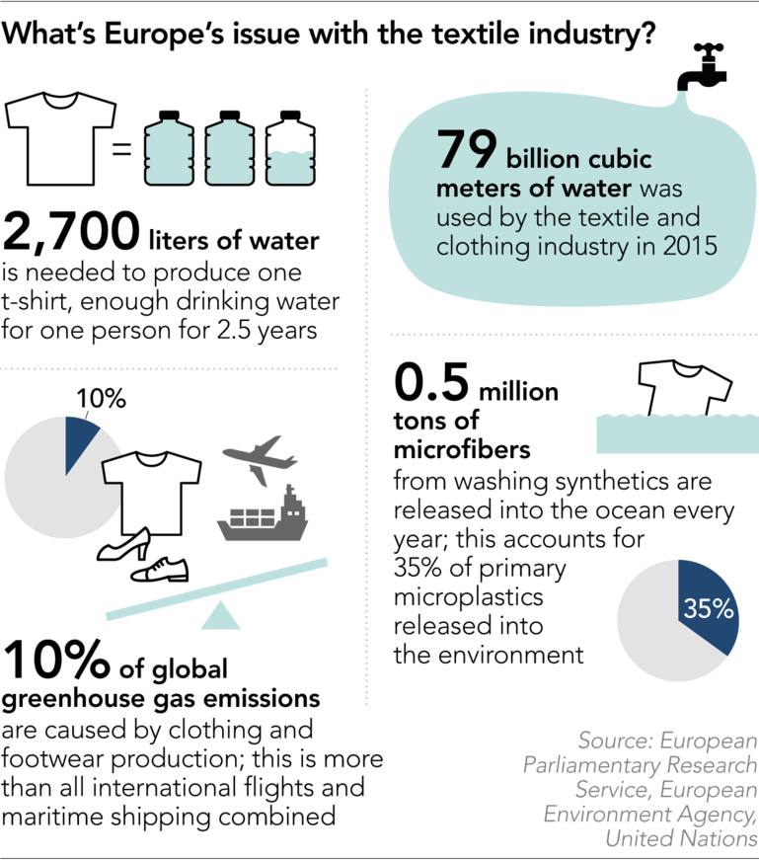
Environmental Impact

Slide 6

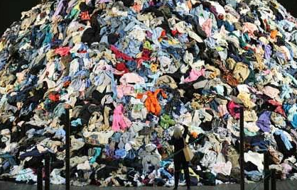
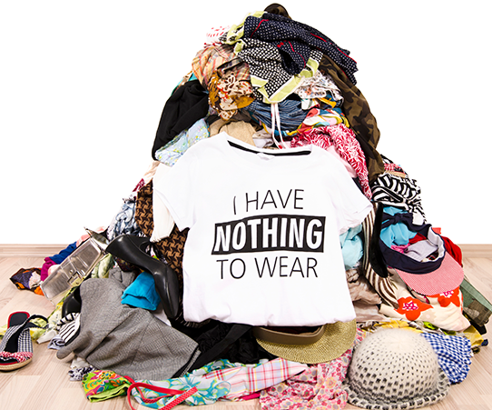



Perspective : From the eyes of Consumer
RELATIVELY CHEAP
DISPOSABLE
FAST
CONFUSING SUSTAINIBILITY CLAIMS
Haute Haas
Caravana
Closet Buttler

Slide 7
Agenda
Chapter
Subject
Page
1
THE Impact
2
Stakeholder Response
3
Managing Emissions
4
Microplastics : Developments & Expectations
5
Valuing Water
6
Putting Textile Waste to Work
7
Chemicals Management : Developments & Expectations
8
PFAS : Need for Chemicals Elimination & substitution
9
Social/Labor Welfare : Developments & Expectations
10
Identifying and managing synergies, dependencies, and trade-offs

Slide 8
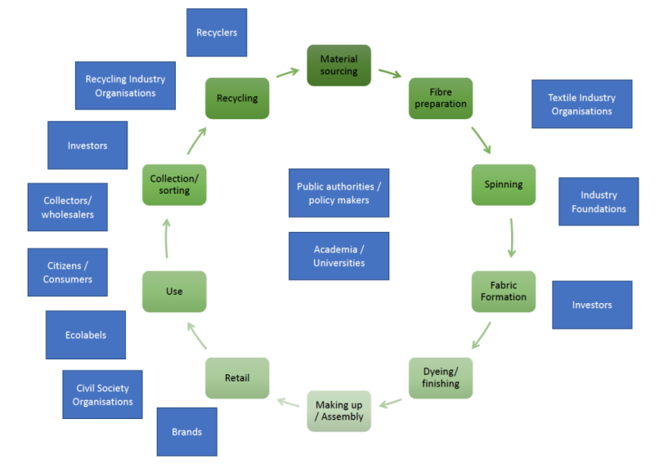
Stakeholders’ Response ?
2
3
4
1
https://ec.europa.eu/environment/system/files/2022-03/Synopsis%20report%20textiles%20strategy.pdf

Slide 9

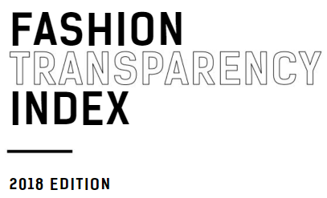

NGOs highlight issues

Slide 10
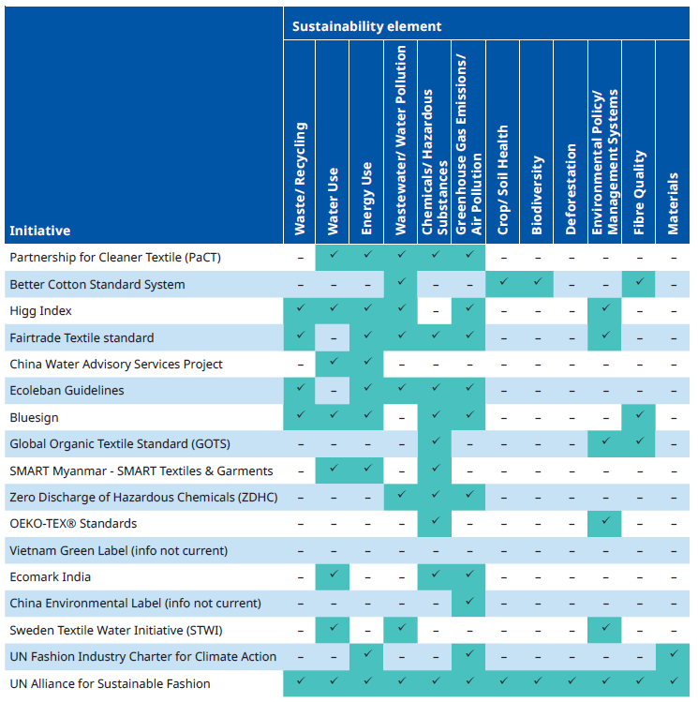
Industry establishes associations, Initiatives, guidelines, etc…
Source: ILO Environmental initiatives in Textile sector

Slide 11
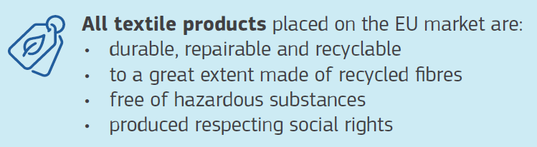
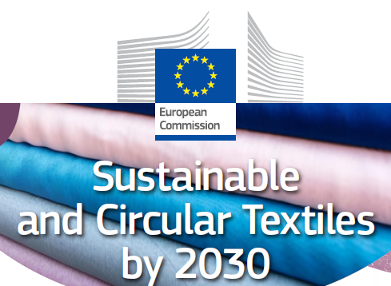
Policy Makers aim for a level playing field

Slide 12
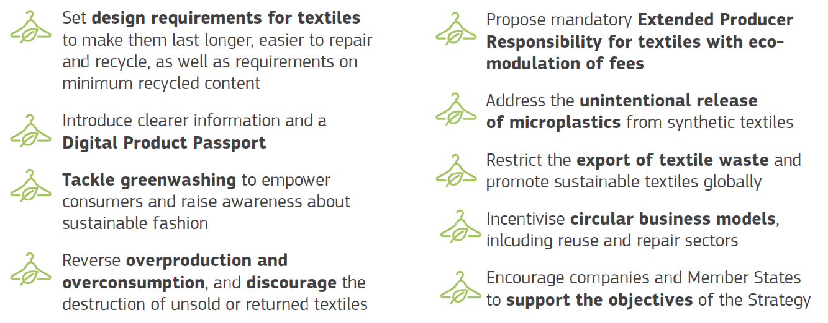
Key actions in the Textiles Strategy

Slide 13
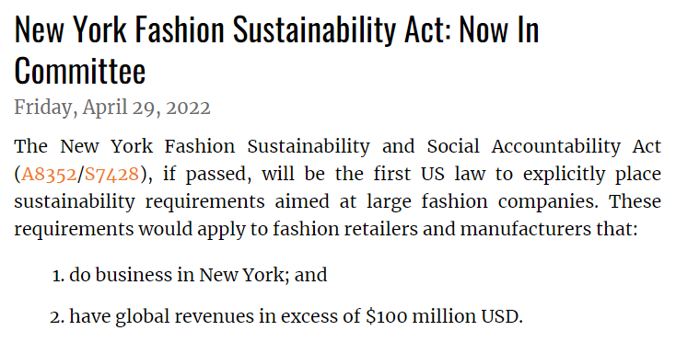
More Policy Plans…
https://www.natlawreview.com/article/new-york-fashion-sustainability-act-now-committee

Slide 14
Academic/Research Institutes enhance focus
Microplastic
HKUST
BUTEX
BUFT
NUST
HCMUT
Waste Management
BUFT
RUPP
ITC
Student Exchange
NTU
BUFT
HCMUT
Short Course
ITC
Sustainable Fiber
BUFT
Wastewater
BUFT
NUST
HTU
Green Product
HTU

Slide 15
Agenda
Chapter
Subject
Page
1
THE Impact
2
Stakeholder Response
3
Managing Emissions
4
Microplastics : Developments & Expectations
5
Valuing Water
6
Putting Textile Waste to Work
7
Chemicals Management : Developments & Expectations
8
PFAS : Need for Chemicals Elimination & substitution
9
Social/Labor Welfare : Developments & Expectations
10
Identifying and managing synergies, dependencies, and trade-offs

Slide 16

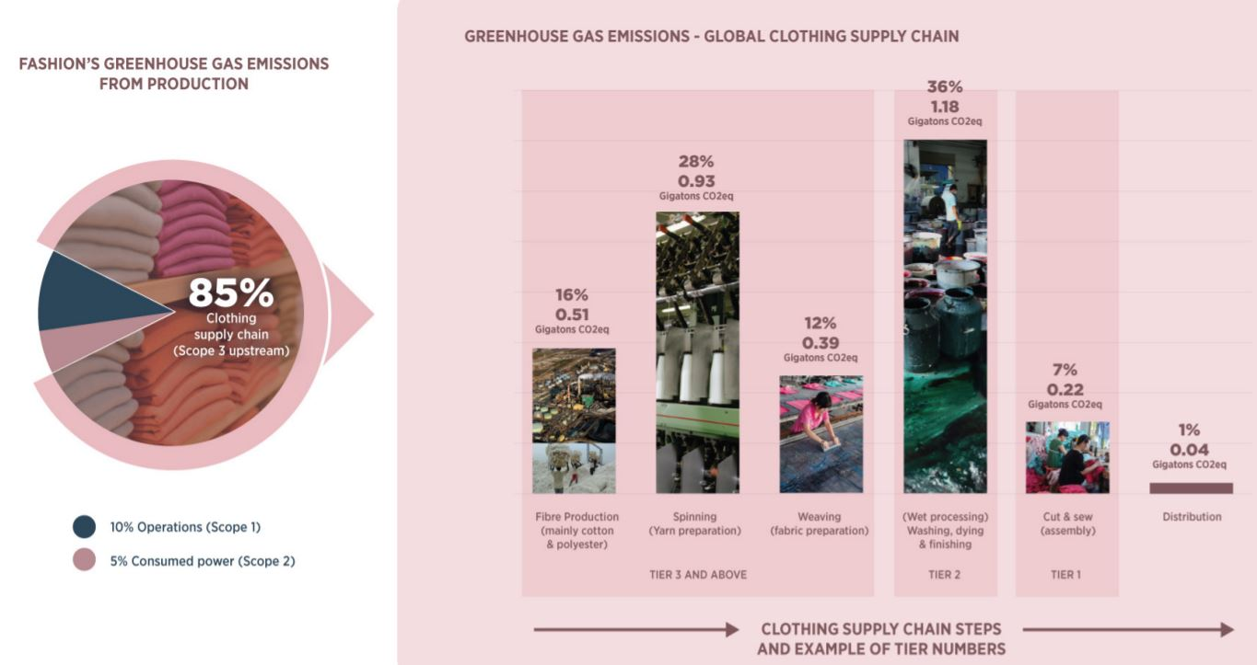
Enhanced Focus on emissions

Slide 17
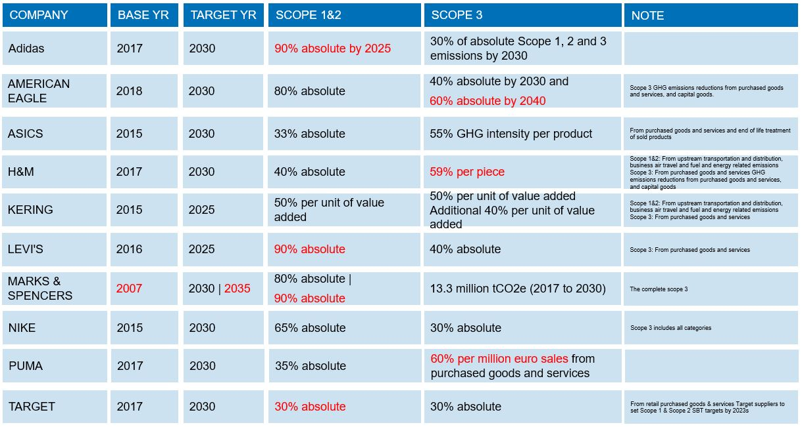

Commitments & Plans

Slide 18
Agenda
Chapter
Subject
Page
1
THE Impact
2
Stakeholder Response
3
Managing Emissions
4
Microplastics : Developments & Expectations
5
Valuing Water
6
Putting Textile Waste to Work
7
Chemicals Management : Developments & Expectations
8
PFAS : Need for Chemicals Elimination & substitution
9
Social/Labor Welfare : Developments & Expectations
10
Identifying and managing synergies, dependencies, and trade-offs

Slide 19
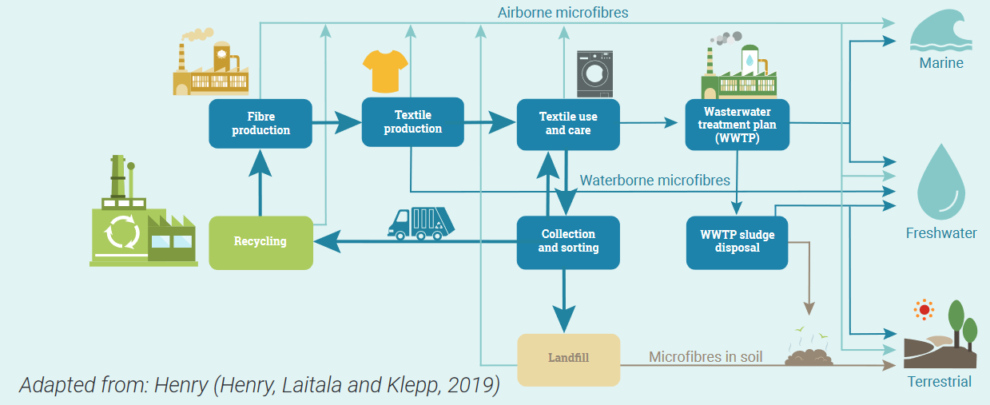
Textiles & Microfibres
Source : UNEP, Sustainability and Circularity in the Textile Value Chain

Slide 20







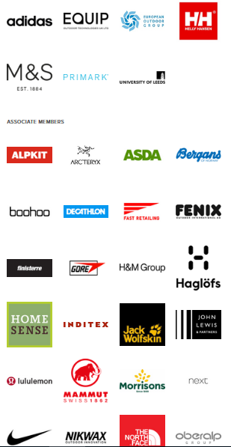


Status-Quo
Continued Developments
Policy
EU
Standards/Research
Brands Involved
ABCD
Link

Slide 21
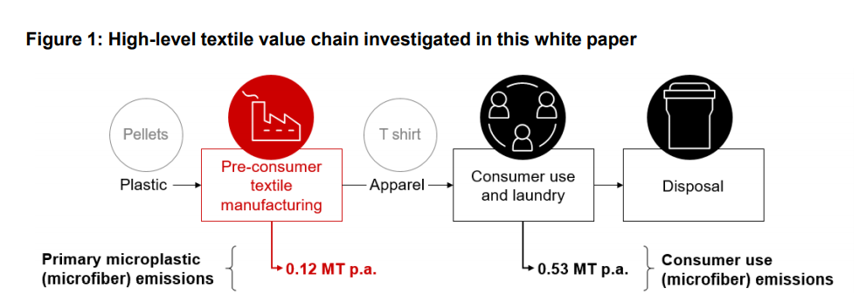
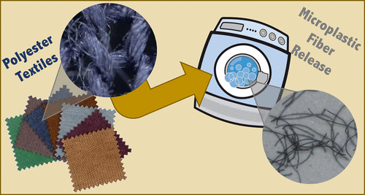
Holistic Evaluation & Assessment
Micro plastics (nature.org)
https://pubs.acs.org/doi/10.1021/acs.est.7b01750

Slide 22
Agenda
Chapter
Subject
Page
1
THE Impact
2
Stakeholder Response
3
Managing Emissions
4
Microplastics : Developments & Expectations
5
Valuing Water
6
Putting Textile Waste to Work
7
Chemicals Management : Developments & Expectations
8
PFAS : Need for Chemicals Elimination & substitution
9
Social/Labor Welfare : Developments & Expectations
10
Identifying and managing synergies, dependencies, and trade-offs

Slide 23
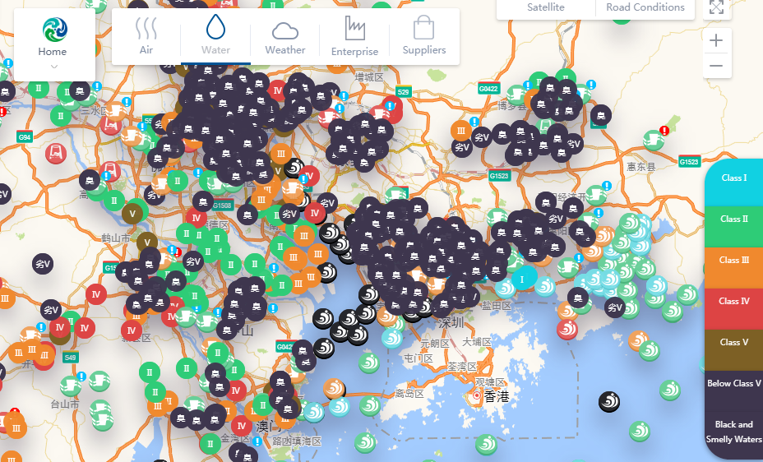
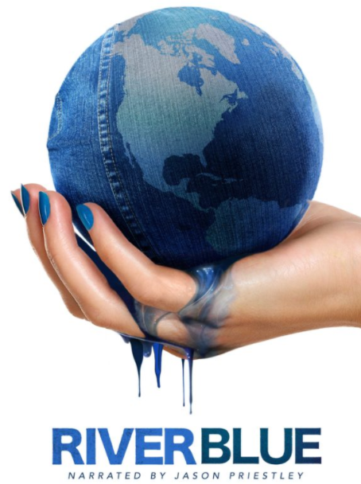
Status-Quo
Image Source : IPE

Slide 24

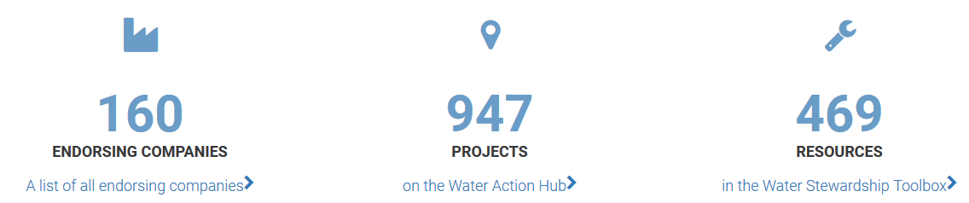



Commitments towards Water Stewardship

Slide 25
Agenda
Chapter
Subject
Page
1
THE Impact
2
Stakeholder Response
3
Managing Emissions
4
Microplastics : Developments & Expectations
5
Valuing Water
6
Putting Textile Waste to Work
7
Chemicals Management : Developments & Expectations
8
PFAS : Need for Chemicals Elimination & substitution
9
Social/Labor Welfare : Developments & Expectations
10
Identifying and managing synergies, dependencies, and trade-offs

Slide 26
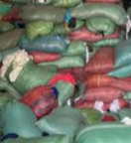
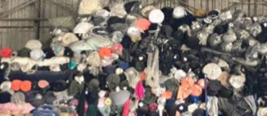
Putting Textile Waste to Work
Paper and Carton
Plastic & Poly
Cutting Waste
Waste
NPO
(Non-product Outputs)
Fabric end Rolls
Hazardous Waste
Wastage with Economic value
Non-Hazardous waste

Slide 27
Agenda
Chapter
Subject
Page
1
THE Impact
2
Stakeholder Response
3
Managing Emissions
4
Microplastics : Developments & Expectations
5
Valuing Water
6
Putting Textile Waste to Work
7
Chemicals Management : Developments & Expectations
8
PFAS : Need for Chemicals Elimination & substitution
9
Social/Labor Welfare : Developments & Expectations
10
Identifying and managing synergies, dependencies, and trade-offs

Slide 28
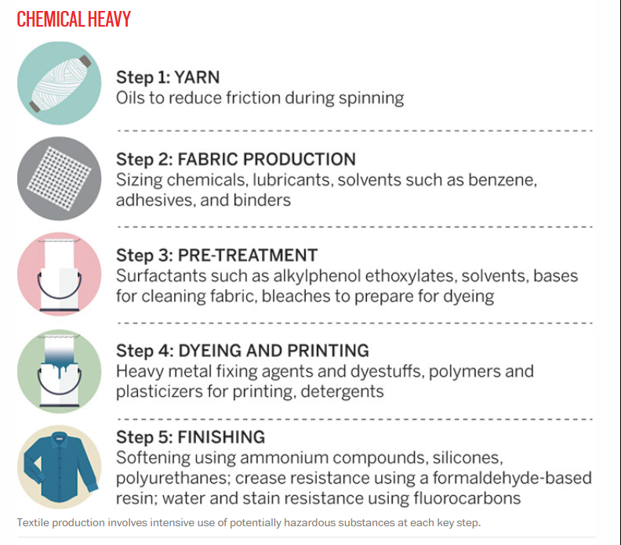
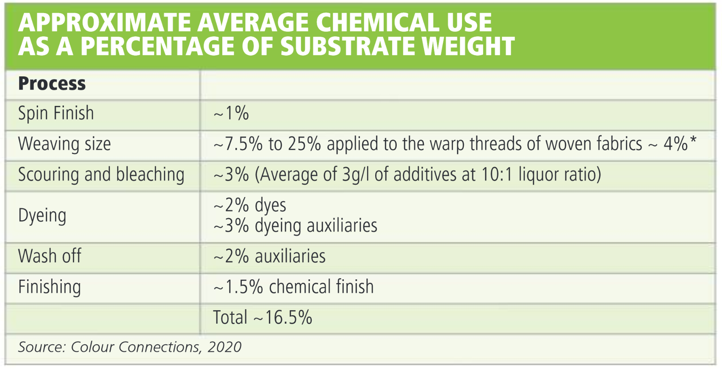
Chemicals are crucial
Source: Ecotextile.com

Slide 29
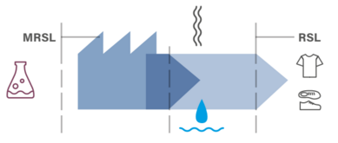
NEW Approach : Chemical Management in Textile/Footwear Industry
Source : ZDHC
NEW Approach :
PROCESS CHECK (AUDIT) +
PROCESS CHEMICAL TEST (MRSL) +
WASTE WATER TEST
SUPPLIER CAPACITY DEVELOPMENT (TRAINING)
LEGACY Approach :
FINISHED PRODUCT TEST (RSL)
Notes:
This is represented with the new approach for Chemical Management or rather compliance
Whereby in addition to RSL requirements for finished products, there is also emphasis on production process AND input chemistry which is governed by MRSL

Slide 30
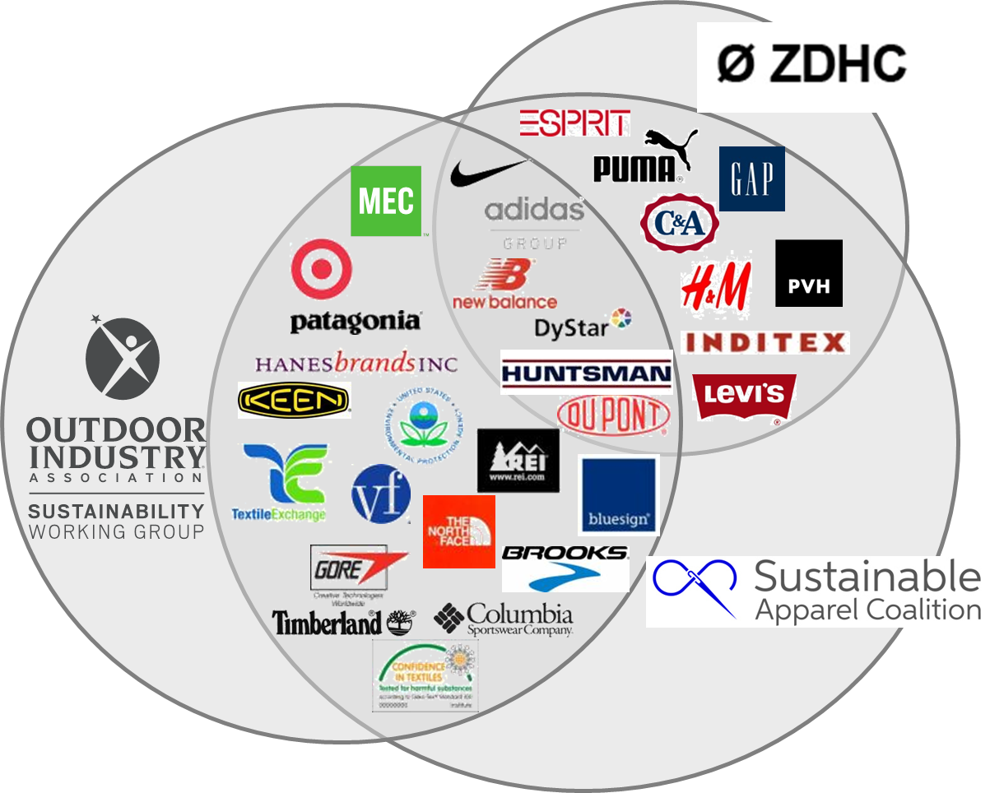
Industry Initiatives (~ 40% of world’s fashion industry)
Active in US, EU, China
https://www.roadmaptozero.com/contributors/
https://www.amfori.org
https://apparelcoalition.org/members/
Active in US, EU
Active in US, EU, China
Partial List
Source : Outdoor Industry Association
Notes:
While there are associations like AAFA, AFIRM that issues harmonized RSL;
3 industry associations came together to address chemical management in production.
These had overlapping membership and areas
Eg: ZDHC and SAC were working on audit module
OIA and ZDHC working on Research
ACTION > Click on link to show members.
The total members involved is approximately equal to 38% of worlds fashion industry, so there is significant buying volumes

Slide 31
Agenda
Chapter
Subject
Page
1
THE Impact
2
Stakeholder Response
3
Managing Emissions
4
Microplastics : Developments & Expectations
5
Valuing Water
6
Putting Textile Waste to Work
7
Chemicals Management : Developments & Expectations
8
PFAS : Need for Chemicals Elimination & substitution
9
Social/Labor Welfare : Developments & Expectations
10
Identifying and managing synergies, dependencies, and trade-offs

Slide 32




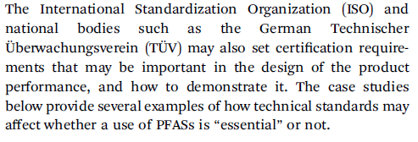
PFAS (Per- and Polyfluoroalkyl Substances) in focus
Phasing out from consumer products, such as toys, childcare articles, cosmetics, detergents, food contact materials and textiles, the most harmful substances, which include among others endocrine disruptors, chemicals that affect the immune and respiratory systems, and persistent substances such as per- and polyfluoroalkyl substances (PFAS), unless their use is proven essential for society;

Slide 33
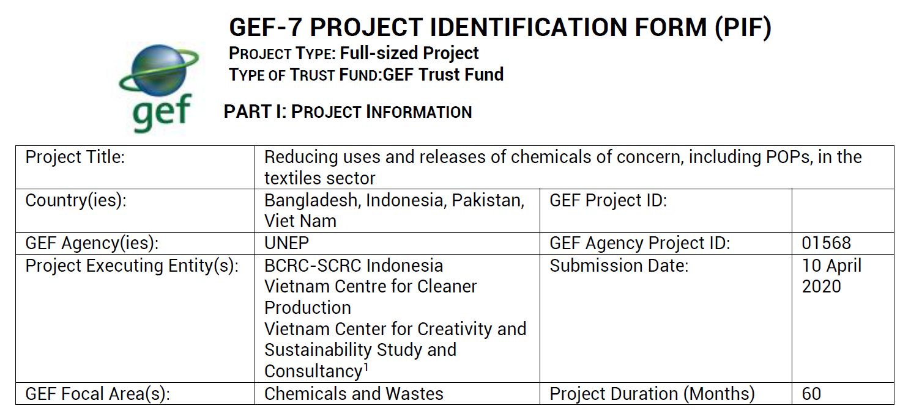
UNEP Project kicked-off via NRDC

Slide 34
Agenda
Chapter
Subject
Page
1
THE Impact
2
Stakeholder Response
3
Managing Emissions
4
Microplastics : Developments & Expectations
5
Valuing Water
6
Putting Textile Waste to Work
7
Chemicals Management : Developments & Expectations
8
PFAS : Need for Chemicals Elimination & substitution
9
Social/Labor Welfare : Developments & Expectations
10
Identifying and managing synergies, dependencies, and trade-offs

Slide 35
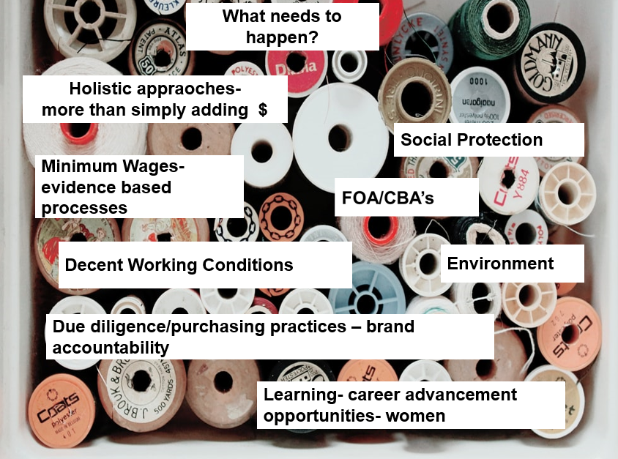
From Fair Wages towards > Living Wages + Better Buying Practices

Slide 36
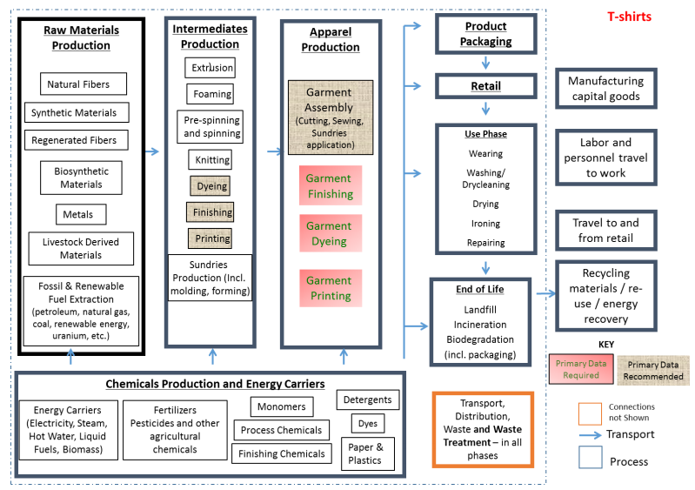
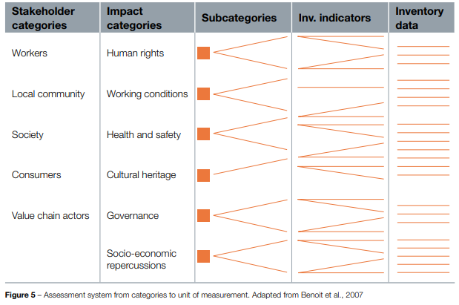
Considerations for Environmental + Social LCA
SAC LCA study

Slide 37
Agenda
Chapter
Subject
Page
1
THE Impact
2
Stakeholder Response
3
Managing Emissions
4
Microplastics : Developments & Expectations
5
Valuing Water
6
Putting Textile Waste to Work
7
Chemicals Management : Developments & Expectations
8
PFAS : Need for Chemicals Elimination & substitution
9
Social/Labor Welfare : Developments & Expectations
10
Identifying and managing synergies, dependencies, and trade-offs

Slide 38
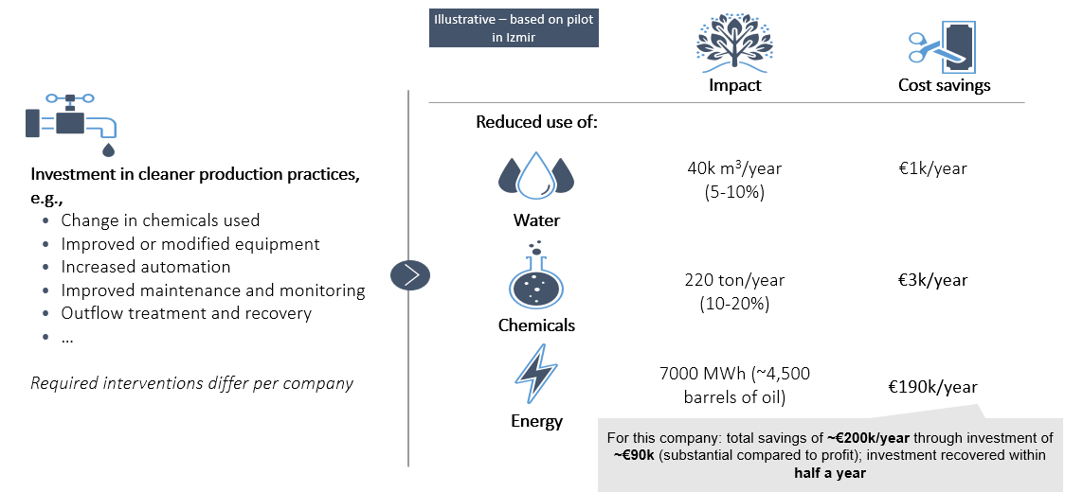
WWF Turkey

Slide 39
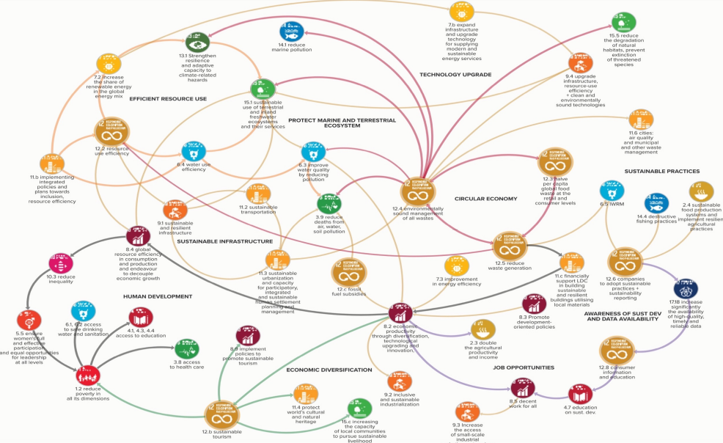
Notes:
As you would imagine, many of our best and brigtest were involved developing the SDGs, and while these 17 SDgs look like separate initiatives, They are all ofcourse connected.
Progress on SDG12, will not only contribute to CE goals , Resource Efficiency plans; but the innovation required will also propel Human Development forward

Slide 40
Wheels for progress towards greater Sustainability
Hotspots identified
01
Innovation-Era
On steroids
Knowledge & Education
02
05
Policy
Finance/ESG for Good
03
Demand & Commitment
04

Slide 41
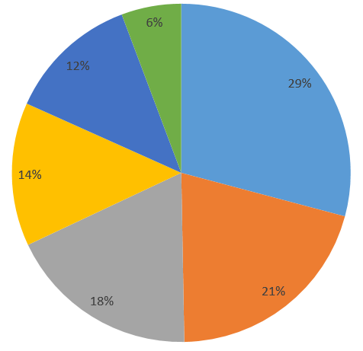

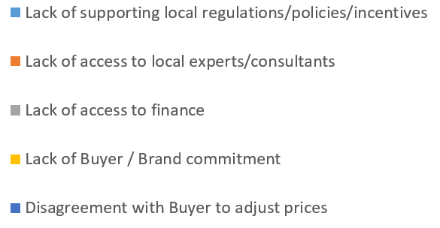

Roadblocks in implementing Environmental/Sustainable practices?
From TUV Rheinland’s webinar survey 2021

Slide 42
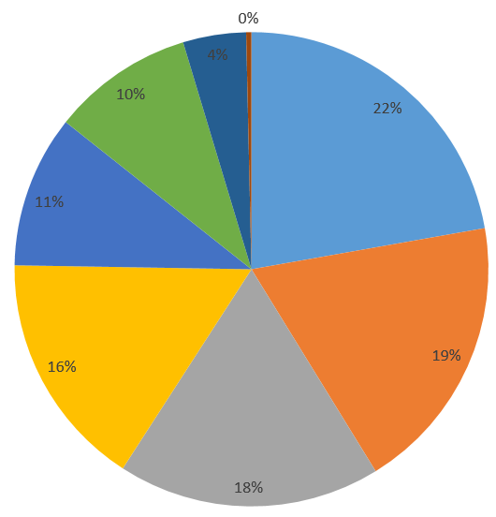
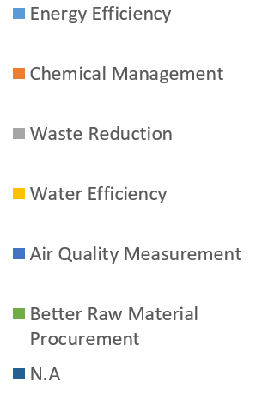
Areas do you plan to invest in, to fast track sustainability improvements?
From TUV Rheinland’s webinar survey 2021

Slide 43
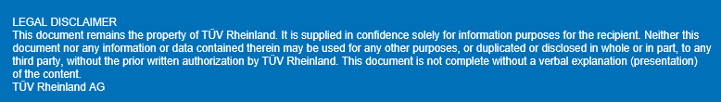
Thank you for your time and attention
Questions/Comments/Feedback/Criticism ?
Rakesh Vazirani
Head of Sustainability Services, Business Stream Products
Rakesh.Vazirani@tuv.com
+852 21921552
www.tuv.com/detox

