Slide 1
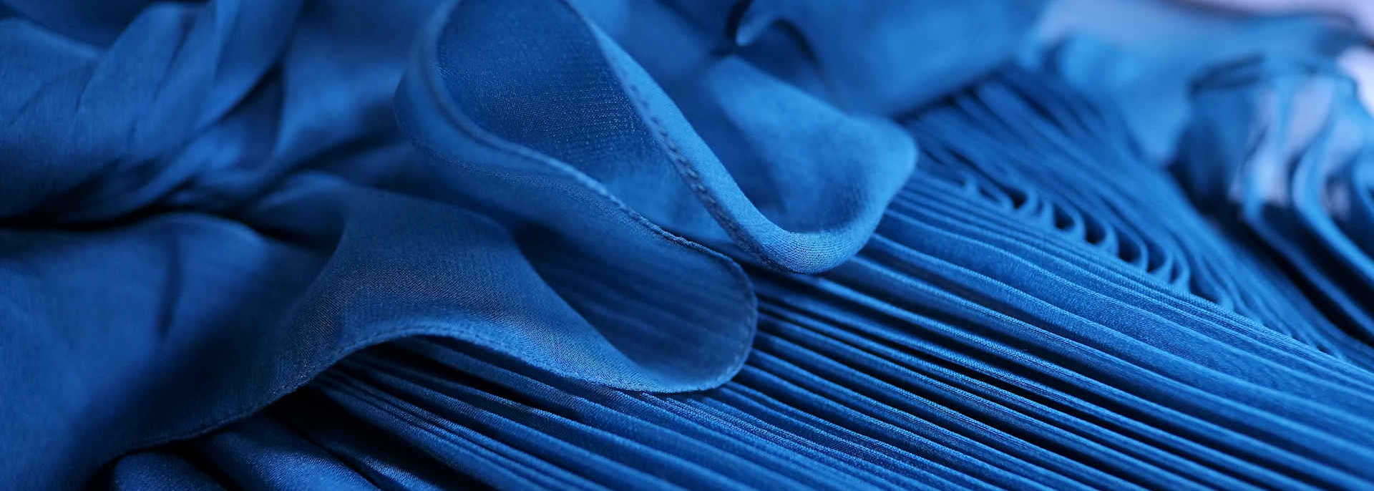
TRAINING OF TRAINERS PROGRAMME ON
CAPACITY DEVELOPMENT OF ETP OPERATORS
Promotion of Sustainability in the Textile and Garment Industry in Asia - FABRIC​

Slide 2
Day 1:
Presentation 2
Water for industries:
Importance & need for conservation

Slide 3
Textile industry in Bangladesh
Importance of water
Water consumption & need for conservation
Contents
Actions needed

Slide 4
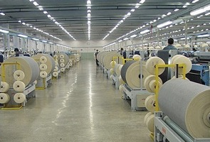
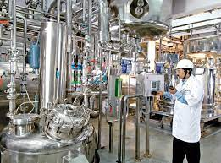
Industry in Bangladesh
Industry accounts for about 31% of the total 350 billion dollar GDP of Bangladesh.
Major industries include:
Textile industry
Pharmaceutical industry,
Shipbuilding industry,
Information technology,
Leather industry,
Steel and light engineering industry.
About 15-20% of GDP is contributed by textile industry, mainly RMG alone.
It is clear how important this industry is.

Slide 5
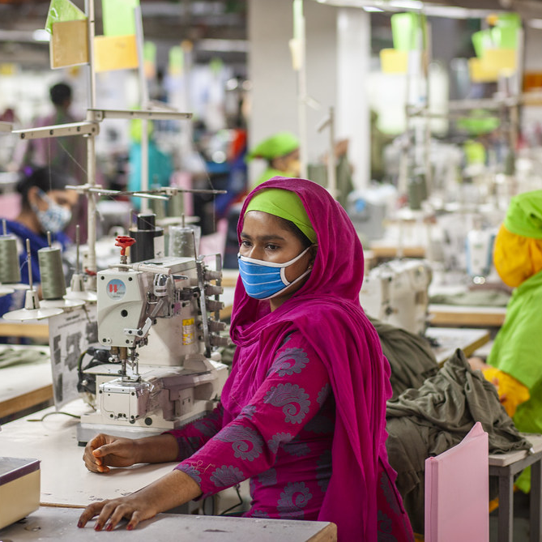
Textile industry in Bangladesh
Despite many challenges, textile industry maintained a steady growth rate for the past two decades.
It currently stands at No.2 position in the world for RMG exports, steadily catching up with the No.1, i.e., China.
The industry has flourished due to
their high productivity at relatively cheaper labour,
good quality control in production and
trust earned with brands & buyers.
A major reason, often not highlighted, for this growth is the apparent availability of copious water.

Slide 6
QUIZ
In your opinion, in a day, how much water is used in total by the textile industry of Bangladesh?

Slide 7
Importance of water in Textile Industry of Bangladesh
Depending on process/product, 1 kg of raw material may consume 75-250 litres of water.
Some reports pegs current total water consumption at 4500 million litres per day
The textile processing is a water intensive industry.
This may rise to 7000 million litres per day by 2030.

Slide 8
Importance of water in Textile Industry of Bangladesh
Most of the industry in Dhaka uses ground water since they are not happy with river water quality.
In many places in and around Dhaka, the groundwater table went down alarmingly low.
This may jeopardise the entire industry and our economy, employment and growth of the country.
Still no concrete plans have been drawn to ensure sufficient water for sustained growth of industry.
To continue growth, protect jobs and increase exports, water security to be ensured.

Slide 9
Water!
The elixir of life.
Water made a tiny planet named earth, in one corner of Universe, to be different!
All the civilisations so far were developed around a water body, mostly rivers.
For millions of years, mother earth preserved it- until one species, humans, decided to destroy it.
We use water for all our needs, agriculture & industry without any control - water scarcity.
The earth, as it is, may not survive at this rate for another century even!

Slide 10
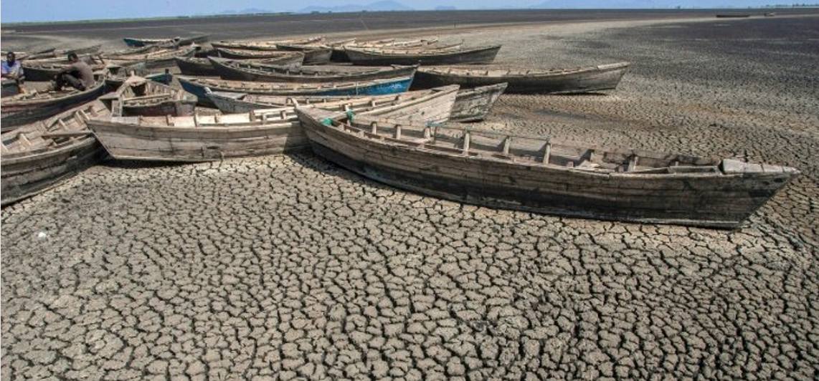
Water!
Where did all the water go?

Slide 11
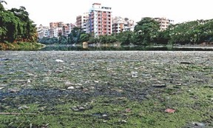
How did we achieve this ’remarkable’ feat?
Pollution of rivers, lakes - making it unusable and unliveable for water species.
Deforestation - leading to floods in rains and scorching heat in summer.
Control of rivers preventing its natural flow. Less said about sand mining etc., the better!
Mindless construction & other activities - global warming.
Uncontrolled ground water extraction - squandered a million years’ groundwater reserve in 100 years!
Where this madness is going to lead us to?

Slide 12
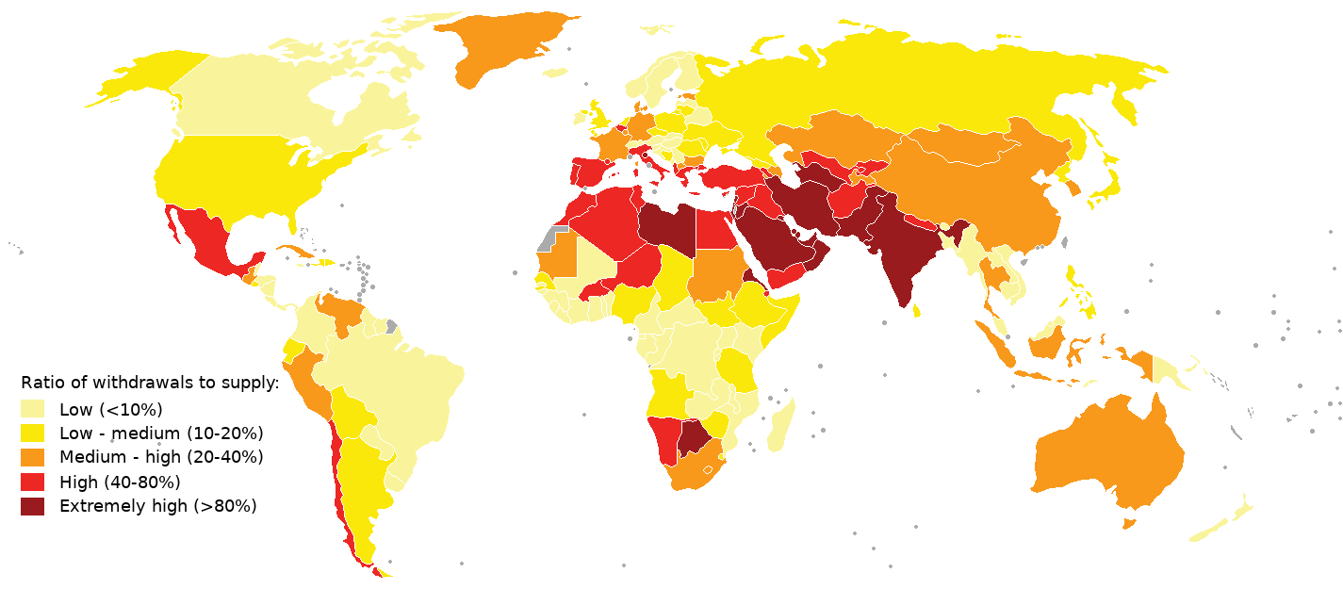
Global water scenario
Do not be happy that Bangladesh is still medium.
It is fast becoming high!

Slide 13
Global water scenario
The minimum one person need would be 20-50 lit/d for drinking, cooking and cleaning.
1.6 million people die every year from diarrheal diseases, 90% of these are children under 5.
We all need water. In general humans need water at the rate of 100-150 lcpd water.
More than one in six people world wide, i.e., more than a billion people, does not have even this 20 l/d!
Water is also important for other activities like agriculture, industry etc.

Slide 14
Water, water everywhere….?
Only a very small fraction (0.014%) is available for human use

Slide 15
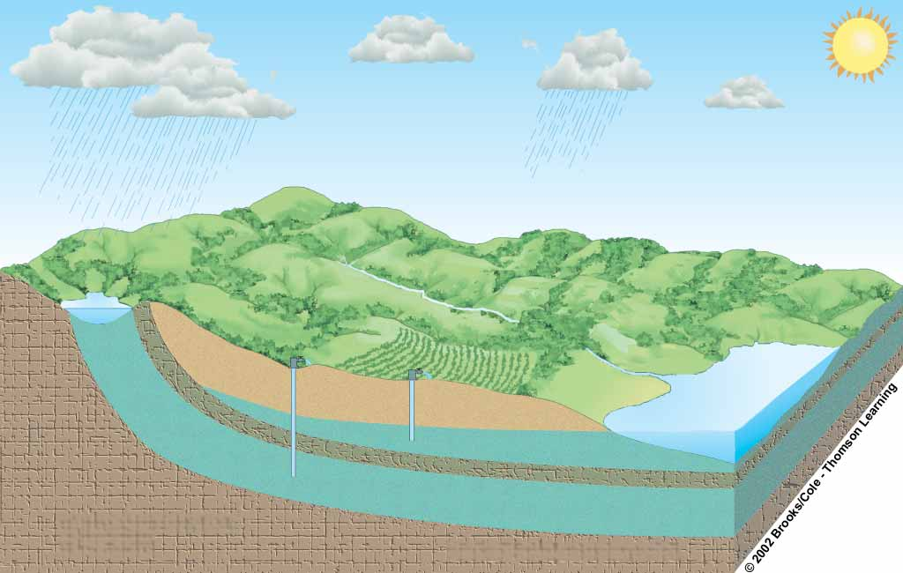
Water cycle, maintained for a million years
Flowing
artesian well
Precipitation
Well requiring a pump
Evaporation and transpiration
Confined
Recharge Area
Evaporation
Runoff
Aquifer
Stream
Infiltration
Water table
Lake
Infiltration
Unconfined aquifer
Less permeable material
such as clay
Confined aquifer
Confirming permeable rock layer

Slide 16
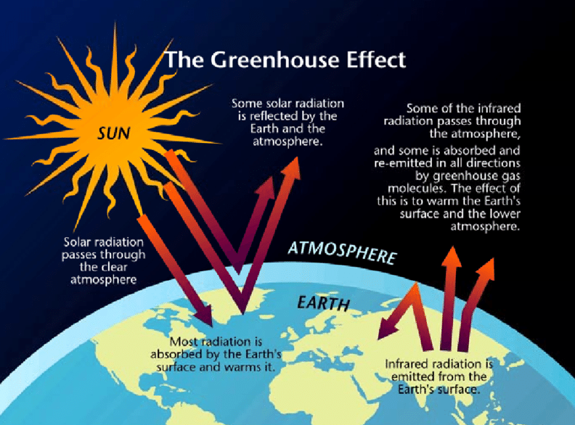
Global warming
We see temperature in summer is increasing every year, but may not know why.
Construction & pollution increase thermal radiation - increase temperature by 4-5^{O}c.
Temperature increase evaporation rates: means loss of more water.
Rapid evaporation of water results in heavy rains at some time creating, flash floods.
Result - no water when needed, flood when it rains!

Slide 17
Change in water consumption pattern in Dhaka

Slide 18
Status of groundwater in Dhaka
in most areas around Dhaka, ground water depletion is in the range of 2 m - 5m annually.
In some areas groundwater level has gone down below 800 ft (250 m).
The depletion is caused by the low re-charge rate.
Magnitude of ground water depletion means present water extraction is more than re-charge
Situation become graver if annual rainfall rates falls.

Slide 19
Water usage by textile industry in Dhaka
Most industries have small land - low rain water recharge against huge withdrawal.
It is like thousands of pumps, continuously pump the groundwater to river!
Groundwater level in most areas very low- water becomes saline or under yielding
Adopting rain water harvesting is good, but the clayey soil, does not allow much water to percolate.
Water scarcity would be disastrous for Bangladesh, depending heavily on textile industry.
Dhaka

Slide 20
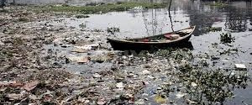
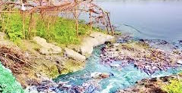
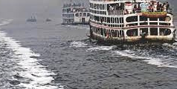
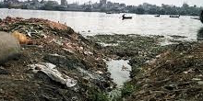
Issue of pollution
Lot of focus already on the huge pollution due to the industry. Rivers, viz., Chilai, Turag/Buriganga, Shitalakkhya, Balu and Bangshi-all heavily contaminated.
DO levels in these rivers are unsustainable for aquatic organisms. Even the industry does not want to use this water!
Despite installation of ETPs in recent times, complaints only intensifies. May be situation will improve with more ETPs option for biological treatment.
However, besides pollution, a grave threat to the industry, often ignored, is “ LOSS OF WATER”

Slide 21
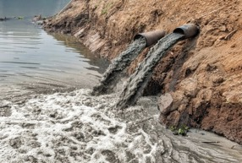
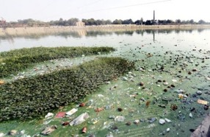
Effluent inflow & conditions of River Turag today!

Slide 22
Why to do proper effluent treatment?
Industries install ETPs for legal requirement, satisfy buyers/brands. Some has environmental concern.
The real reason should be…water!
Untreated/undertreated effluent has huge consequence on the water resource.
Water is one of the most important raw material for the textile production.
Interestingly, industry does audits: power/labour/ chemical availability before location finalisation, forget this important raw material…..water!

Slide 23
Impact of effluent discharge
Almost entire quantity of water used in industry is discharged as effluent.
The effluent with or without treatment gets irreversibly lost, once it is discharged into a flowing river.
This discharge of effluent cause loss of water in two ways:
Unfortunately, this direct & indirect loss of water is never taken seriously.
huge quantity of water consumed in the manufacturing gets discharged as effluent and get directly wasted,
When contaminated water reaches a water body, it gets polluted and much more quantity of fresh water becomes unusable.

Slide 24
QUIZ
What are the steps you can take to manage water for textile industry?

Slide 25
What to do?
Minimise ground water consumption by the textile industry : think of alternatives!
Promote cleaner technologies, consume less water in the production.
As a final step, consider recycling & reuse of effluent.
Popularize and promote rain water harvesting as much as feasible.

Slide 26
Conclusion
Water most important requirement of life including industry.
Unfortunately, we are squandering it assuming it endless.
The rapid industrialisation in Bangladesh is the foundation stone for the development and prosperity of the country.
One negative effect was loss of water directly & indirectly due to pollution. This will put the industry in jeopardy.
Serious efforts needed (a) reducing water consumption, (b) efficient operation of ETPs and (c) recycle of water as possible.

