Slide 1
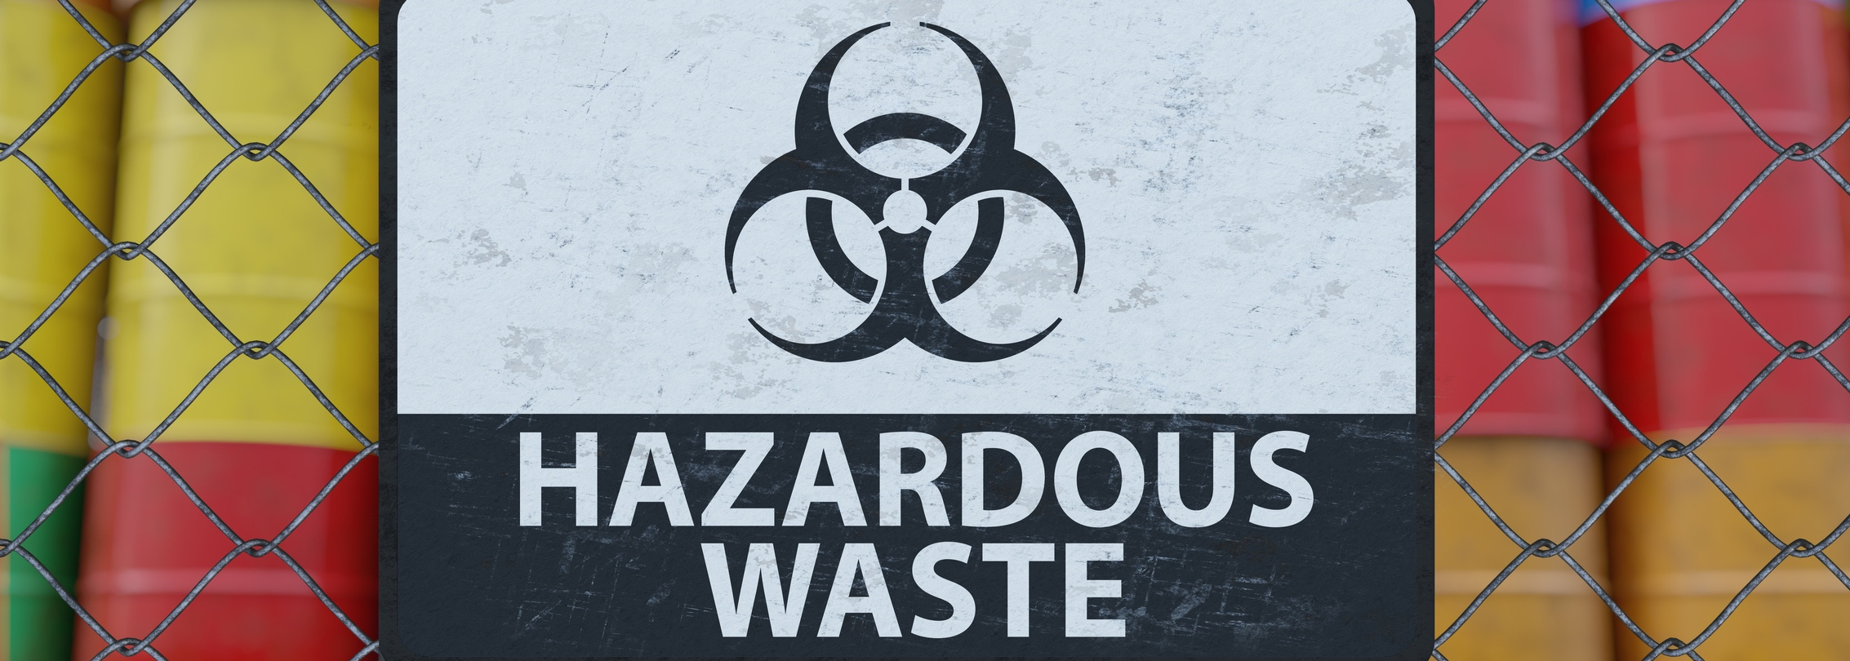
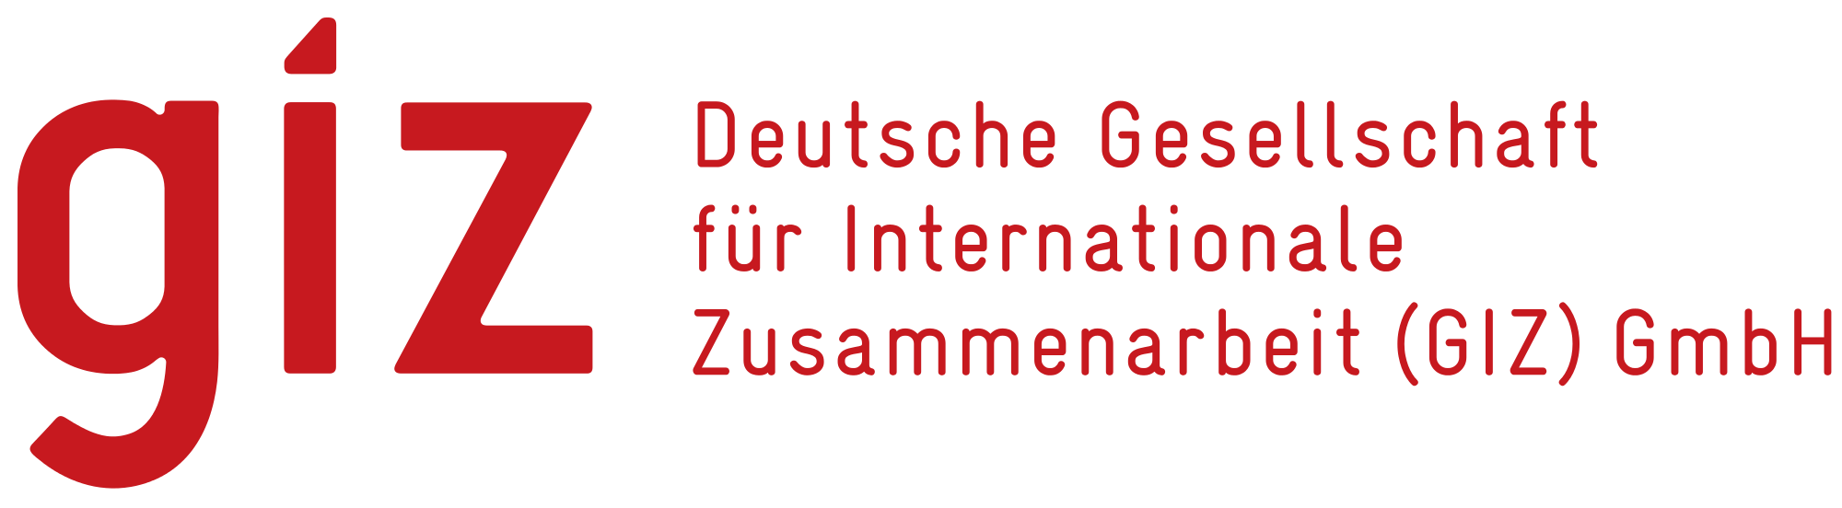

Trainers Training Program on
Waste Management in Textile & Garment Industry in BGD
Promotion of Sustainability in the Textile and Garment Industry in Asia - FABRIC​

Slide 2
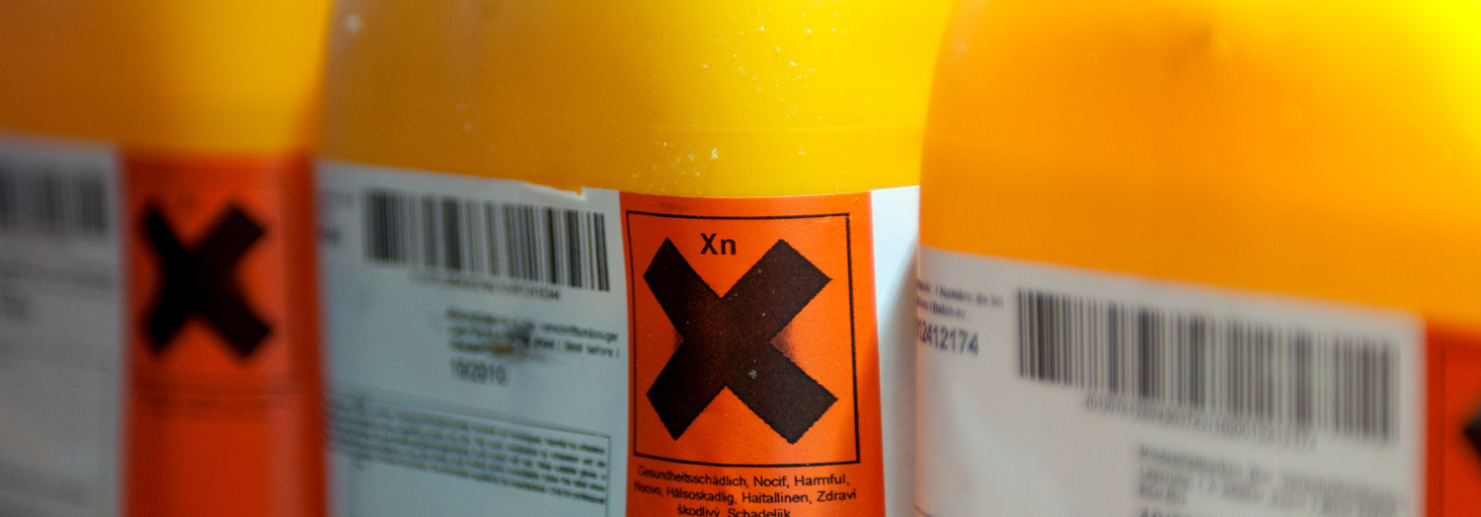
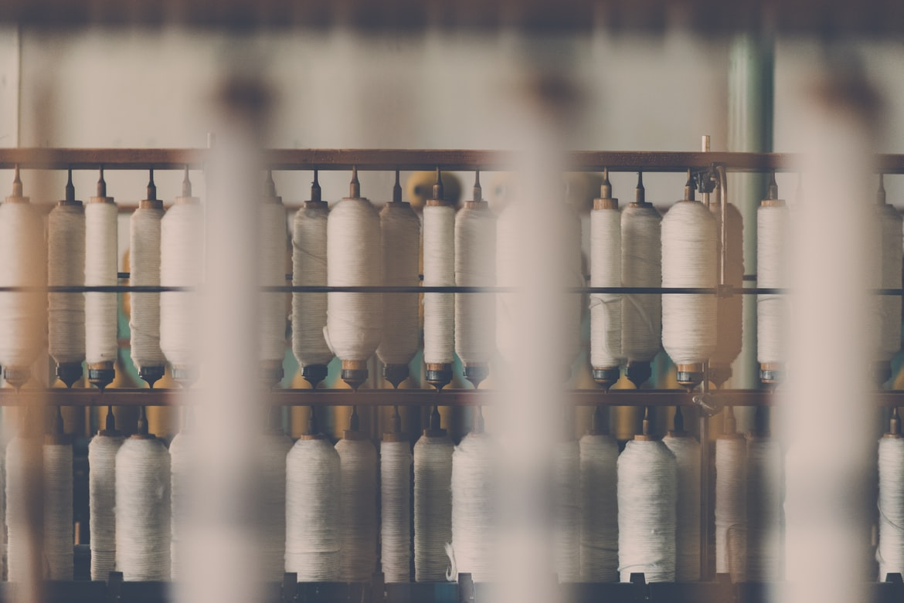
GIZ FABRIC – Waste Management Course
Presentation 4: Hazardous materials in the effluent and its treatment

Slide 3


Sources of hazardous materials the general effluent, hazardous pollutants in garment washing effluent.
Overview of textile waste water treatment techniques.
Concentration of different pollutants including heavy metals, content Vs discharge standards.
Treatment techniques for heavy metals.
Chemical precipitation technique and chemicals used.
Contents
Need to generate & removal of excess sludge from biological treatment.
Sludge characteristics from different type of ETPs.

Slide 4
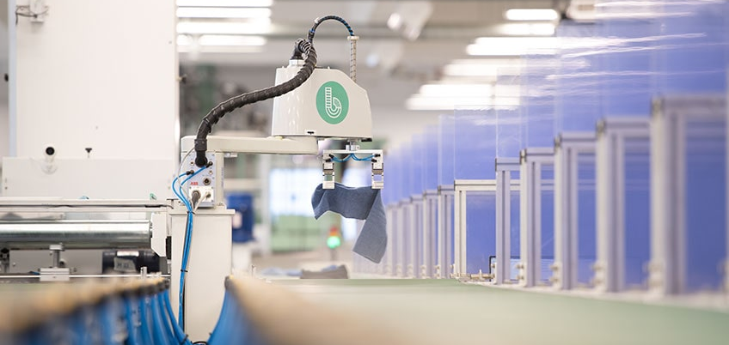
Sources of hazardous materials the general effluent, hazardous pollutants in garment washing effluent

Slide 5
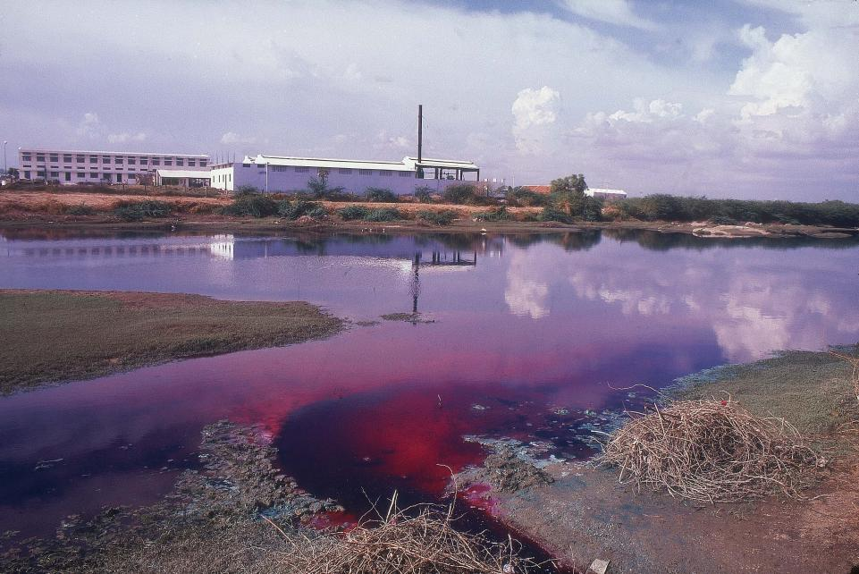
The use of harmful chemicals in the textile sector has consequences for the environment
Water pollution
Pollution of soil and farmland
Hazardous waste generation
Pesticides used for cotton
5
05-11-2022
Training Program on Waste Management

Slide 6
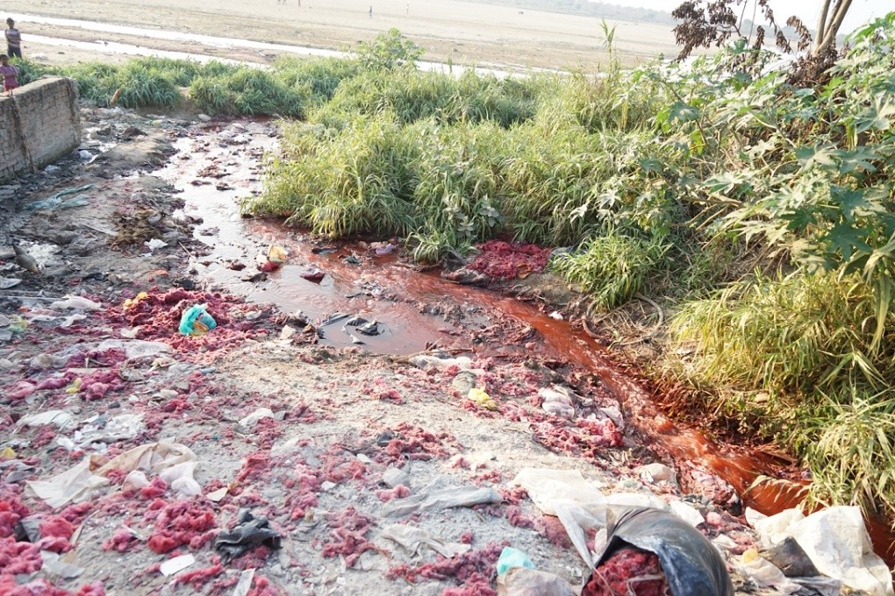
Pollution of soil and farmland
    Hazardous chemicals in wastewater can pollute soil and farmland along rivers
    Sewage sluge containing hazardous chemicals is being applied to land as a soil supplement
    Contaminated soil can lead to contaminated food that is grown on these fields; therefore chemicals can enter the food chain

Slide 7
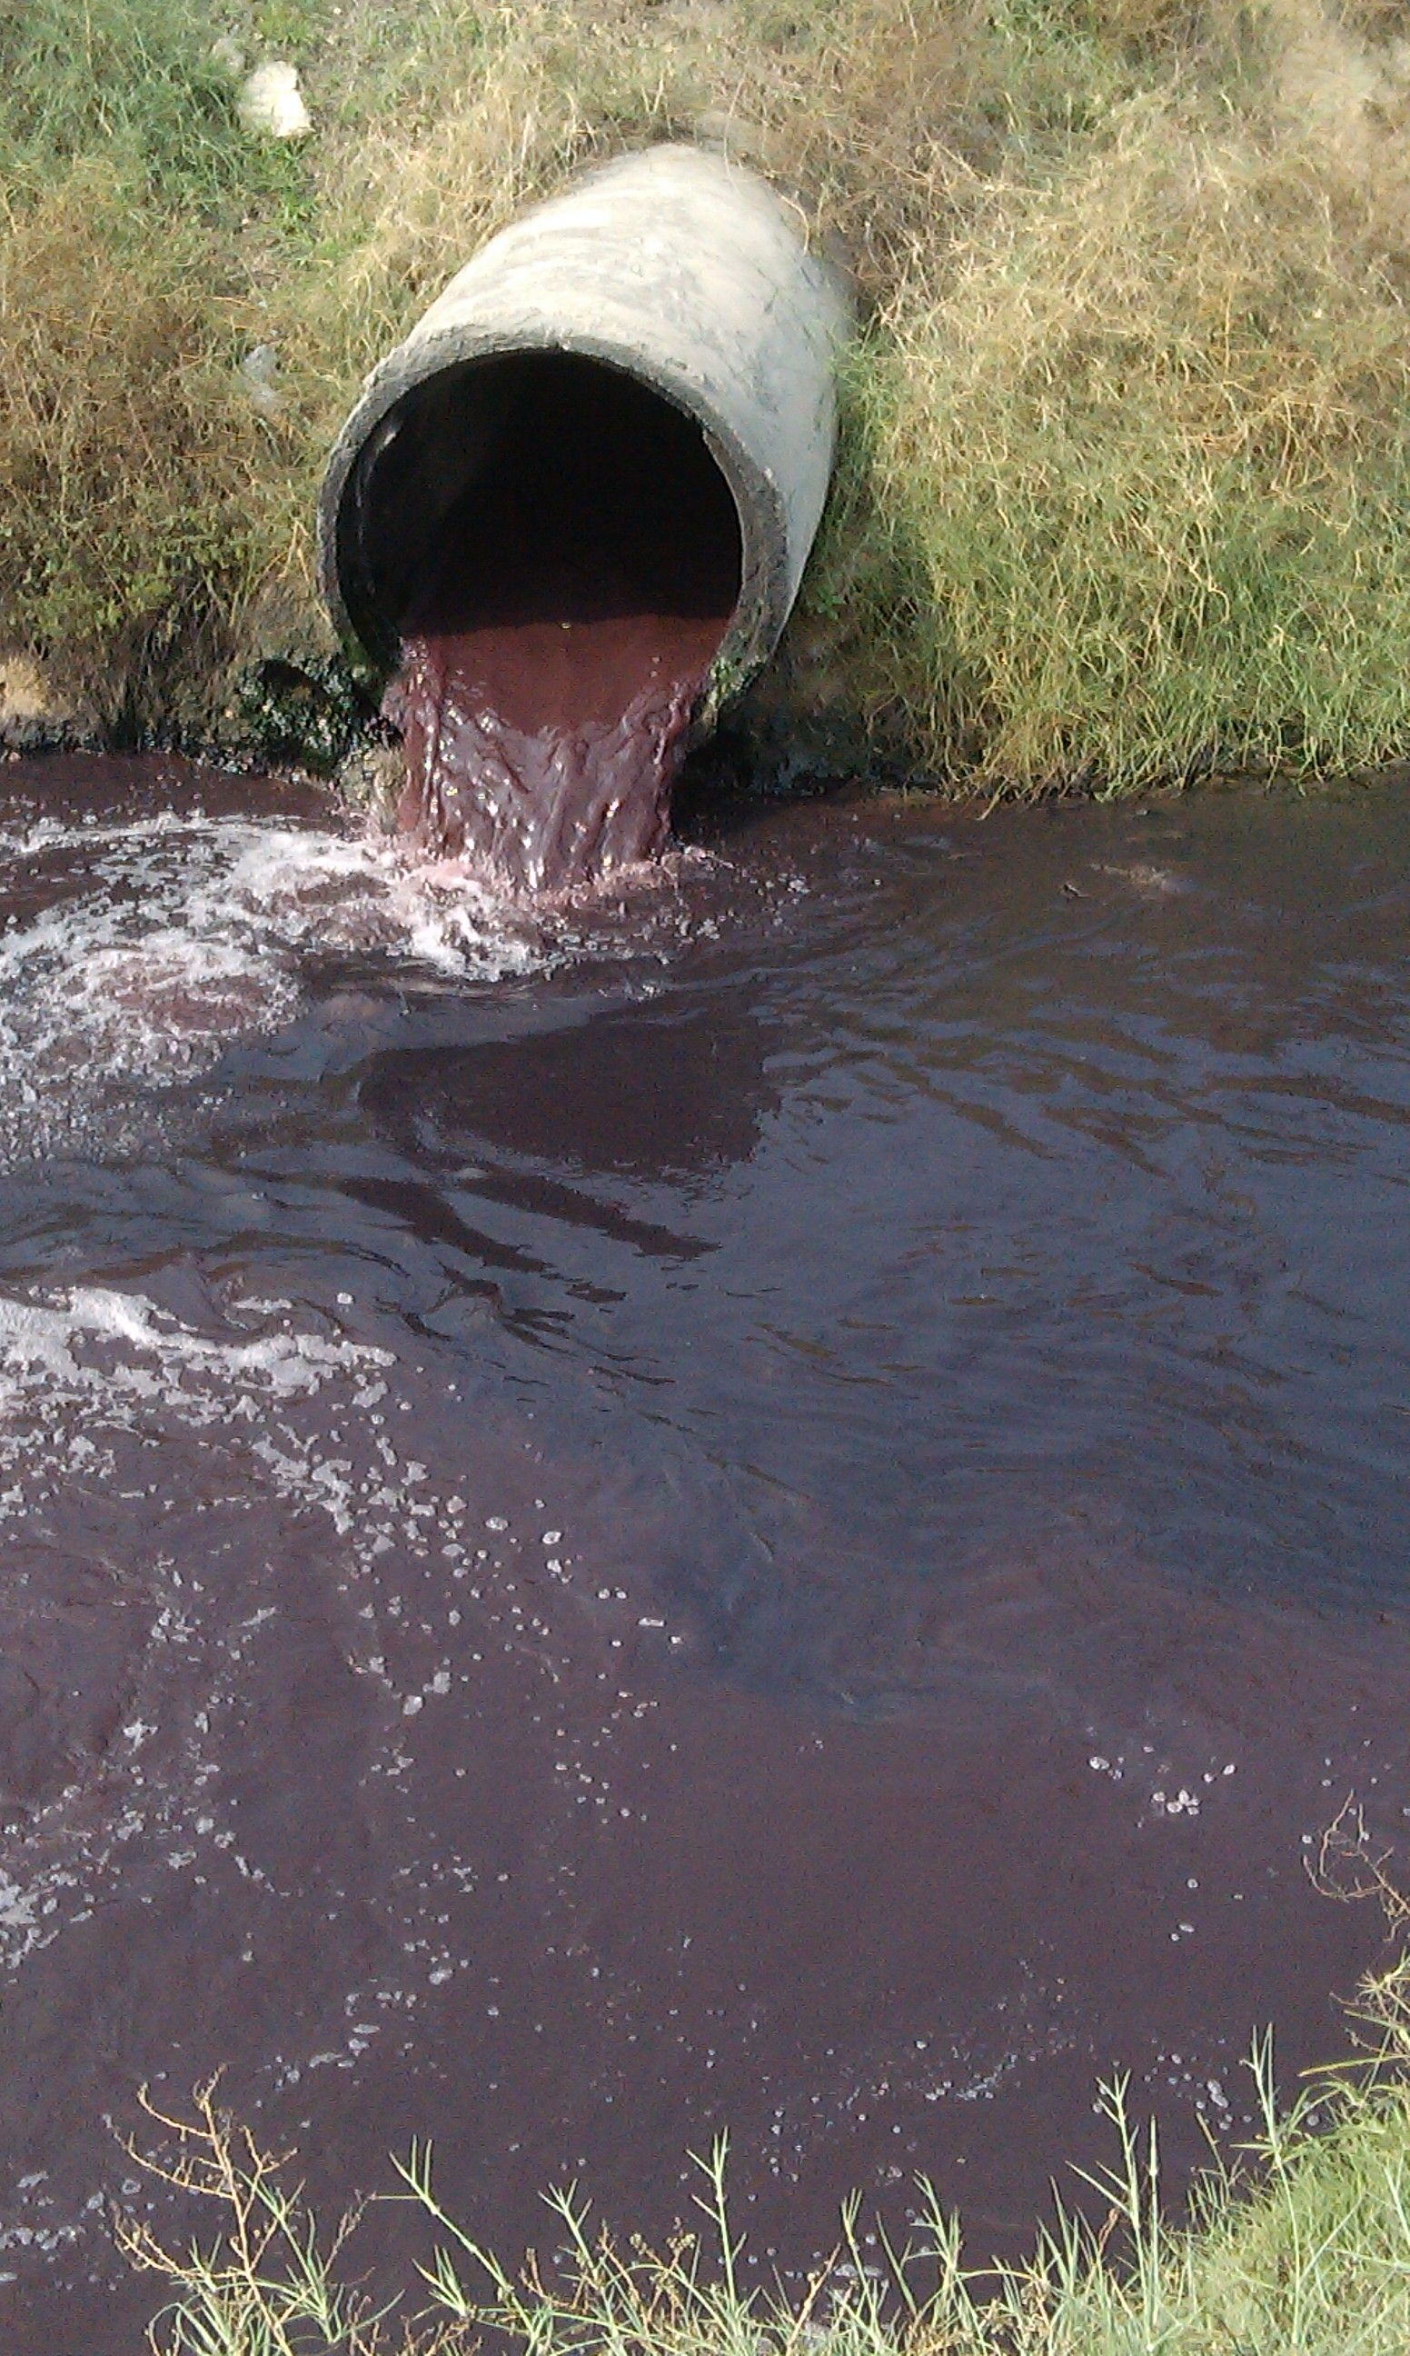
Water pollution
Effluents from textile production pollute freshwater resources
Used hazardous chemicals can even build up in the food chain

Slide 8
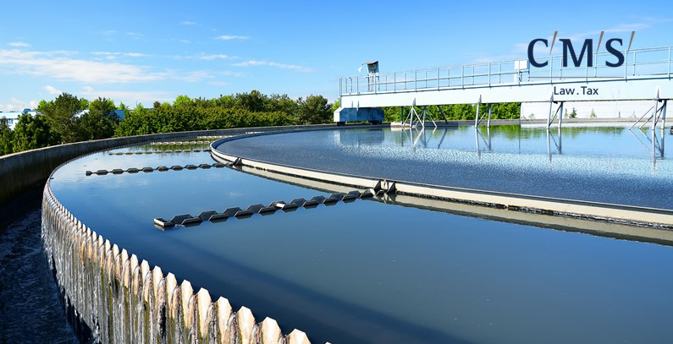
Overview of textile waste water treatment techniques

Slide 9
Classical Waste Water Treatment Techniques
IT WILL BE ELIMINATED
BY
Coarse materiel, sand
Grids Sand traps
Floating materiel separators
Crease and oil
Pretreatment, sedimentation
Settable substances
Sludge
Treatment
Biological treatment
Biodegradable
substances
Clarification
Biol. activated sludge
Water-body

Slide 10
Scheme of the common treatment of waste water from textile industries
Reverse osmosis for removal of colorfulness or reduction of salt
Activated sludge treatment
Adsorption
(aerobic multiple stage process, high detention time tTs, low sludge load BTS, last process unit as fixed bed reactor)
Sand filtration
Waste water
From textile industry
Discoloration by biological process
Treated waste water
Active carbon filtration
Discoloration by chemical process
Precipitation/flocculation or flotation
Mixed waste water from textile industries are generally characterized by organic carbon-containing substances, which concentrations are slightly higher concentrated than in municipal waste water, but are more difficultly to degrade. The concentrations of nitrogen and phosphorous containing substances are lower than in municipal waste water.

Slide 11
Advanced Textile waste water treatment
Process | Main objective Typical | fluxes (L/m2/h)
Microfiltration (MF) | Suspended solids removal including microorganisms and colloids. Reduction in turbidity 90+%. | >50
Ultrafiltration (UF) | Elimination of long chain dissolved substances including colloidal, oil and fatty substances. Turbidity reduction 99%. Good for removal of metal hydroxides to 1 mg/L or less. In textile applications, COD removal is 21 – 77%, colour 31 – 76% and surfactants 32 – 94%. Requires NF or RO to polish the permeate further for dyeing lighter colours. | 50 - 100
Nanofiltration (NF) | Selectively removing of charged ions including calcium and polar substances. Water softening applications and decolourisation. Prone to fouling from colloidal materials and polymers. COD removal 79 – 81% | 1.4 - 12
Reverse osmosis (RO) | Inorganic ions removal to very low concentrations used in desalination. Very sensitive to fouling. Pre-treatment required. COD removal 89 – 91% | 0.05 -1.4

Slide 12
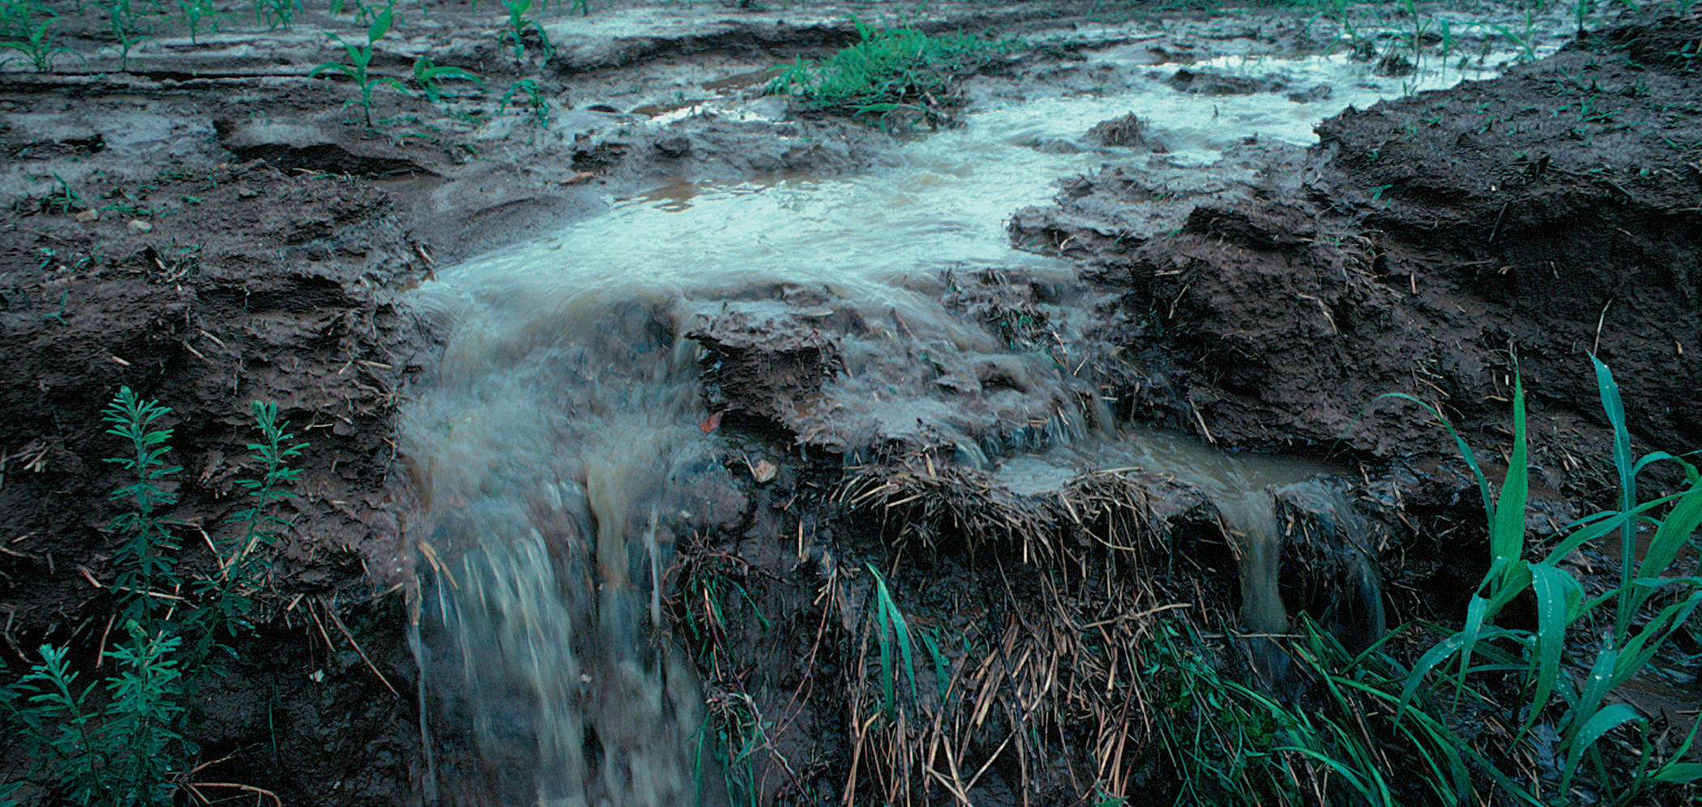
Concentration of different pollutants including heavy metals, content Vs discharge standards

Slide 13
Typical characteristics of untreated textile effluent
pH 6 – 10
Temperature 0C 35 – 45
Total dissolved solids mg/L 1,000 – 12,000
Biological Oxygen Demand (BOD) mg/L 80 – 6,000
Chemical Oxygen Demand (COD) mg/L 150 – 12,000
Total suspended solids (TSS), mg/L 15 – 8,000
Chloride, mg/L 1,000 – 6,000
Free chlorine, mg/L <10
Oil & Grease, mg/L 10 – 30
Total Kjeldahl Nitrogen (TKN) mg/L 70 – 80
Nitrate (NO3) mg/L <15
Free ammonia, mg/L <10
Sulphate, (SO4) mg/L 600 – 1,000
Heavy metals, mg/L <10

Slide 14
Typical characteristics of untreated textile effluent
Parameters | Units | Typical Values | DOE Standards For Waste from Industrial Water Discharge
pH |  | 8-10 | 6-9
Heavy Metals | mg/l | 10 – 15 | Varies depending on type of metal
Suspended Solids (SS) | mg/l | 200 – 300 | 150
Total Disolved Solids (TDS) | mg/l | 5000 – 6000 | 2100
Chemical Oxygen Demand (COD) | mg/l | 1500 – 175 | 200
Bio-chemical Oxygen Demand (BOD) | mg/l | 500 – 600 | 50
Oil & Grease | mg/l | 40 – 60 | 10
Surfactants | mg/l | 10 – 40
Sulfide as S | mg/l | 50 – 60 | 1

Slide 15
Typical characteristics of untreated textile effluent
Parameter | Effluent Discharged Water Standards/Limit (mg/l) ¹ | Standard for Wet Processing ( (mg/l)) ² | Avg. Discharge quality of Bangladeshi ETP’s (Biological Based) (mg/l) ³
Total Suspended Solid (TSS) | 100 | 1 | 15-50
BOD5 20°C | 150* | 50 | 30-50
COD | 200 | 200 | 100-150
DO | 4.5-8 | Not Permitted | 4-5
Oil & Grease | 10 | 1 | 1-3
Total Dissolved Solid | 2100 | 200 | 1500-2100
pH | 6.5-9 | 7-8 | 7-8

Slide 16
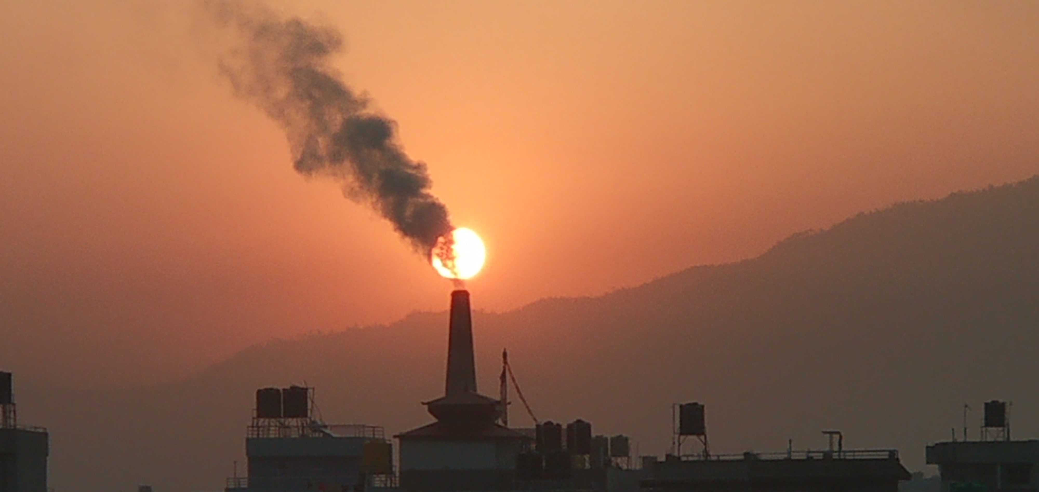
Treatment techniques for heavy metals

Slide 17
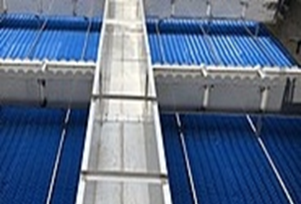
Effluent treatment
Inorganic contaminants – Heavy metals
Vast variety of inorganic pollutants e.g. salts and heavy metals. most relevant in textile production
Common treatment of metals through precipitation
  Possible for most heavy metals as their insoluble salts (such as hydroxides)
  Precipitated by addition of lime and alum/ ferrous salts aided by polyelectrolytes.
  Disadvantage: Metals transferred from liquid effluent to sludge and posing sludge disposal problem

Slide 18
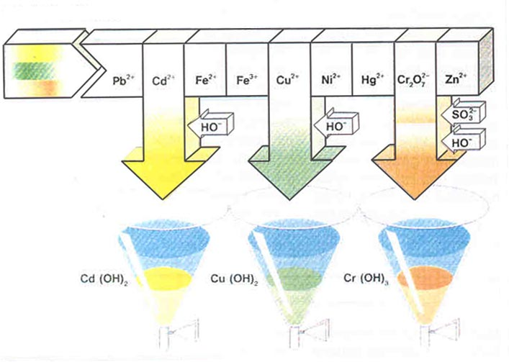
Elimination of Heavy Metals
Industrial waste water

Slide 19
Antimony removal
In fabrics, made of 100% polyester, Sb concentrations as much as 208 mg/kg were found.
During dyeing at high temperature, Sb leaches into the wastewater. Concentrations can reach as high as 175mg/L.
ZDHC recommendations for concentrations of Sb are 0.1, 0.05 to 0.01 mg/L (100, 50 and 10μg/L) as the supplier progresses from foundational and progressive to aspirational. Due to its toxicity, Sb needs to be removed from wastewater.

Slide 20
Antimony removal
Sb exists in many valent forms from the trivalent (Sb3+) to the pentavalent form (Sb5+) which makes its removal more challenging.
The trivalent form is ten times more toxic than other forms. Methods recommended for its removal range from precipitation, ferric chloride coagulation/flocculation, ozone oxidation, membrane separation and adsorption.
Ferric chloride at dosages of 40 – 50mg/L at a low pH followed by microfiltration is a low-cost measure.

Slide 21
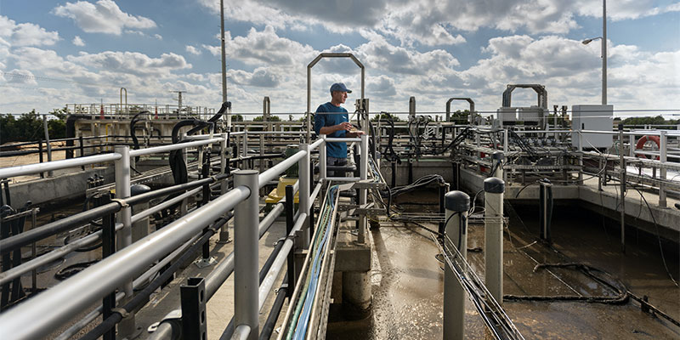
Need to generate & removal of excess sludge from biological treatment

Slide 22
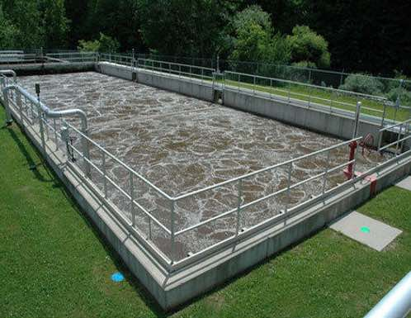
Activated sludge process
In activated sludge process wastewater containing organic matter is aerated in an aeration basin in which micro-organisms metabolize the suspended and soluble organic matter.
Part of organic matter is synthesized into new cells and part is oxidized to CO2 and water to derive energy.
In activated sludge systems the new cells formed in the reaction are removed from the liquid stream in the form of a flocculent sludge in settling tanks.
A part of this settled biomass, described as activated sludge is returned to the aeration tank and the remaining forms waste or excess sludge.

Slide 23
Activated sludge process
Activated sludge plant involves:
wastewater aeration in the presence of a microbial suspension,
solid-liquid separation following aeration,
discharge of clarified effluent,
wasting of excess biomass, and
return of remaining biomass to the aeration tank.

Slide 24
Schematic of activated sludge process
treatmSource: Water Institute of Southern Africa (2002): “Handbook for the operation of waste water treatment plants”ent plants”
Source: Water Institute of Southern Africa (2002): “Handbook for the operation of waste water treatment plants”

Slide 25
Secondary treatment
For removal of organic pollutants, the most efficient process is biological treatment known as Secondary treatment. It primarily employs microbes naturally present in wastewater to break down organic contaminants. Some inorganic compounds like ammonia, cyanide, sulphide, sulphate and thiocyanate are also biologically degradable. Biological processes can be broadly classified as:
Aerobic – microbes that require oxygen to grow
Anaerobic – microbes that grow in the absence of oxygen but uses other compounds such as sulphate, phosphate or other organics present in the wastewater other than oxygen
Facultative – microbes that can grow in the presence or absence of oxygen.
25
05-11-2022
Training Program on Waste Management

Slide 26
Treatment of azo dye wastewater
Reactive azo dyes are not degraded by aerobic treatment, whilst anaerobic treatment is able to degrade reactive azo dyes to aromatic amines which are still toxic, and aerobic systems located downstream of an anaerobic plant are able to degrade them further.
Therefore, the two together, where an anaerobic system is used followed by an aerobic system, produces the best results.
In anaerobic systems if there is sufficient COD, then sufficient biogas can be produced to power a generator.
26
05-11-2022
Training Program on Waste Management

Slide 27
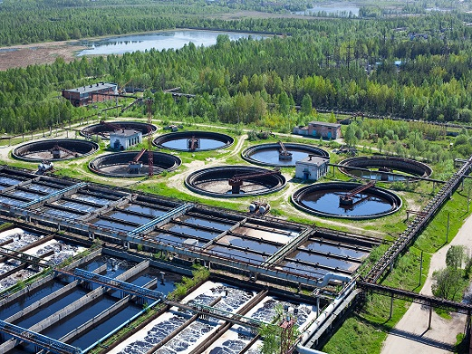
Food to microorganism (F/M) ratio
Food to microorganism (F/M) ratio: A term for expressing the organic loading of an activated sludge process F/M is a critical factor in process design and operation, especially in determining the aeration basin volume. F/M range is about 0.5 – 1.5. For conventional plants, F/M of 0.2 – 0.5 is aimed for. In biological treatment plants operating at high F/M loads (0.8 – 1.5), the rate of treatment increases but at the cost of poor settleability of the sludge.
Processes operating at low F/M loads (0.05 – 0.2) are associated with slow BOD removal rates but with good sludge settling. However, the system can be easily upset by a spike load of organics.

Slide 28
Sludge age
Sludge age is also known as Mean Cell Residence Time (MCRT) and Solids
Retention Time (SRT): is calculated as the total quantity of sludge in the aeration tank and clarifier divided by the daily sludge losses through waste activated sludge and effluent. Sludge age can vary from 0.5 to 75 days in low-growth rate systems. However, in conventional systems it is 3 – 15 days and in textile wastewater treatment plants 20 – 30 days. Sludge Age is an indication of F/M ratios. Shorter times are indicative of high F/M ratios and longer times are indicative of low F/M ratios. Sludge age is expressed as:
Sludge age = Sludge mass in (Aeration tank + Clarifier) / daily sludge losses.

Slide 29
Sludge Volume Index (SVI)
Another useful indicator is the Sludge Volume Index (SVI). Sludge is poured to a 1L graduated cylinder and the percentage of settled sludge in 5 minute intervals is noted for 30 minutes.
SVI is expressed in mL/g. It is a reliable troubleshooting test. SVI values can vary from 30 to 400 mL/g. Values below 150 indicate good sludge settling and above this indicate sludge bulking.

Slide 30
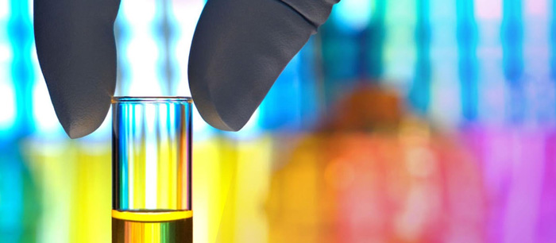
Chemical precipitation technique and chemicals used

Slide 31
Organic pollution removal
Chemical precipitation
Basic concept
  Coagulated colloidal particles very small.
  Combination of particles through flocculation to bigger flocs amenable to settling/flotation.
  Solids separation through sedimentation as well as dissolved air flotation & filtrations

Slide 32
Organic pollution removal
Chemical precipitation
Targeting suspended and colloidal organics
Involving coagulation, flocculation and solids separation for removal but not destruction of organics.
  Commonly used coagulating agents: Metallic salts, iron- and aluminum-salts
  Polyelectrolytes
  Newer coagulation methods include electro coagulation.

Slide 33
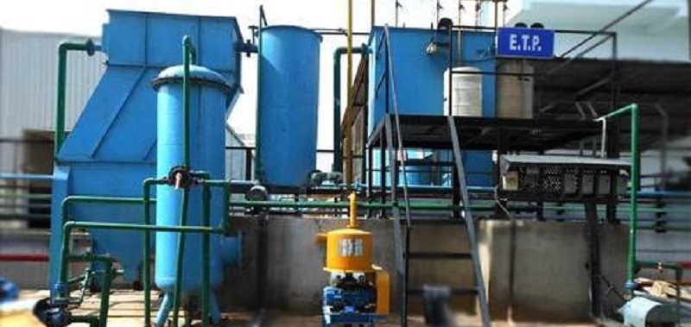
Sludge characteristics from different type of ETPs

Slide 34
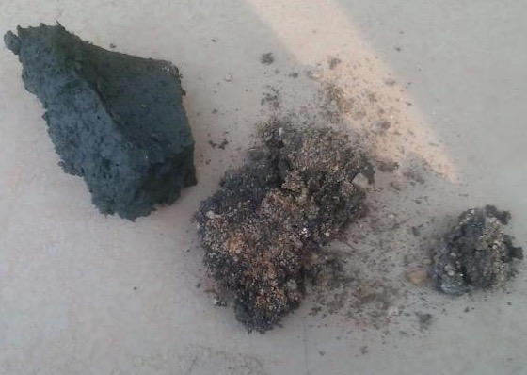
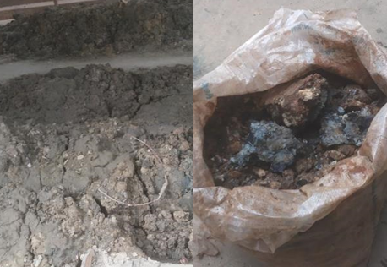
Sludge
A residual semi-solid material formed as a by-product from industrial and municipal wastewater treatment.
A residue of effluent treatment plants (ETP) independent of applied treatment:
  Physio-chemical.
  Biological.
  Chemical.

Slide 35
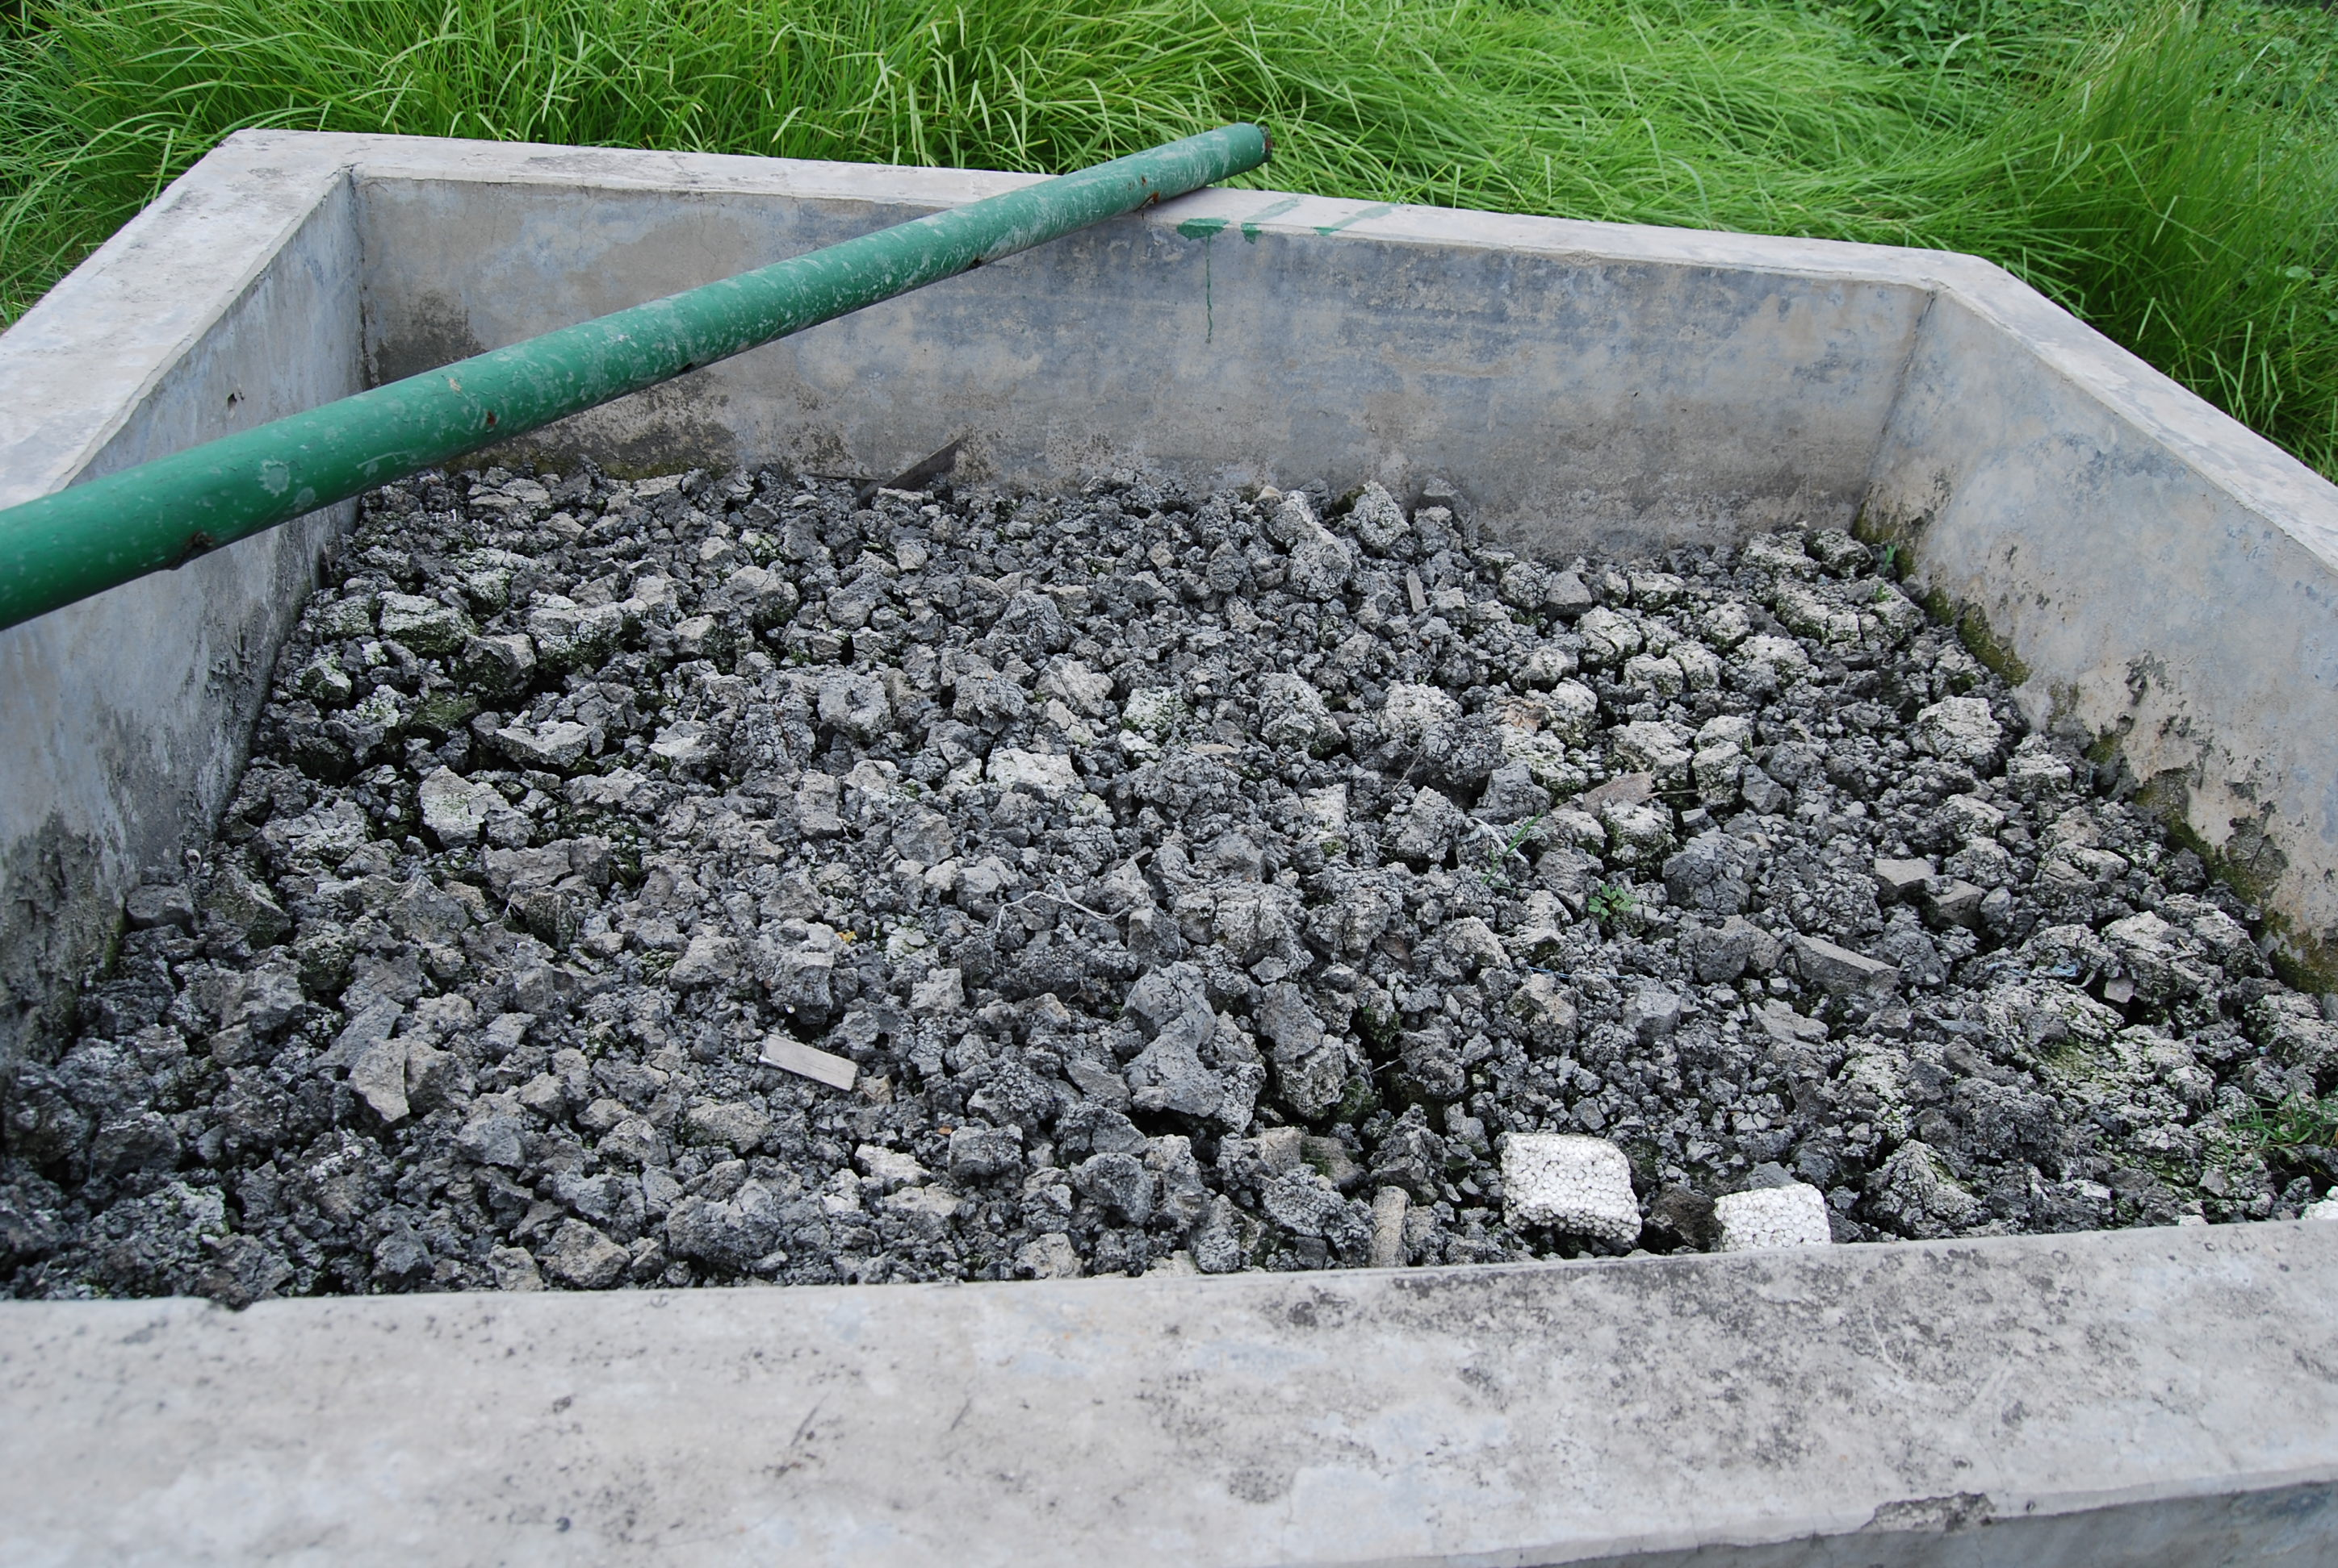
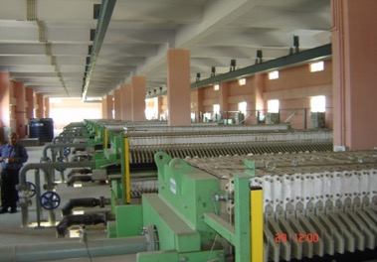
Sludge dewatering and drying
Sludge characteristics
Liquid sludge generally of 3 - 4% solids;
Wasted liquid sludge from aeration tank usually about 1% solids and 2 - 3% after thickening;
Dewatered sludge usually 25 - 35% dry solids content

Slide 36
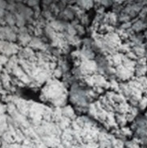
Sludge Handling
Disposal
Landfill.
Incineration.
Upcycling.
Sludge / solid waste from the effluent stream could potentially contain high levels of chemicals, and requires proper handling and disposal:
Disposal must meet all local requirements.
Safety protocol need to be followed when handling sludge.
Sludge must be disposed of through a qualified disposal company.
Removal of Moisture
Thickening.
Dewatering.

Slide 37
Sludge disposal requirements in Bangladesh
Parameter | Unit | Category A | Category B | Category C
Cadmium, Cd | mg/kg | 10 or less | 11 – 85 | > 85
Chromium, Cr | mg/kg | < 600*** | < 600 | > 600
Copper, Cu | mg/kg | 800 or less | 801 – 4300 | > 4300
Lead, Pb | mg/kg | < 840** | < 840 | > 840
Nickel, Ni | mg/kg | 200 or less | 201 - 420 | > 420
Zinc, Zn | mg/kg | 2500 or less | 2501 – 7500 | > 7500
Mercury, Hg | mg/kg | 8 or less | 9 - 57 | > 57
To simplify classification approach, acceptable limits for major sludge quality parameters defined in the Guideline for Sludge Management in Bangladesh Textile Sector
Threshold differentiates by categories A, B and C
37
05-11-2022
Training Program on Waste Management

Slide 38

Group work
Discuss your experience with wastewater testing.
What were your challenges?
What solutions have you found to positive test results?
15 min Group Work, please document your results
38
05-11-2022
Training Program on Waste Management

